Slide 1
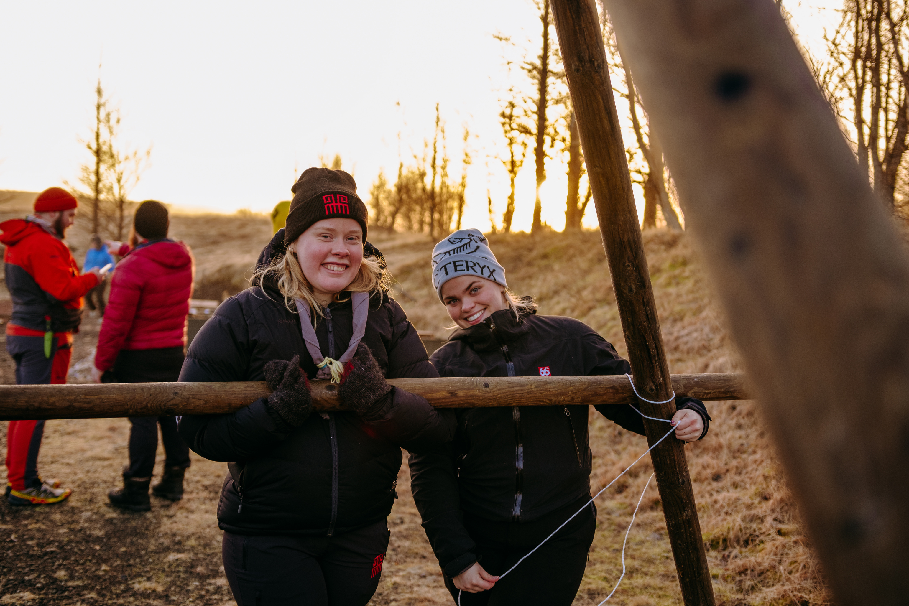

Sustainable events
How can we help each other?

Slide 2
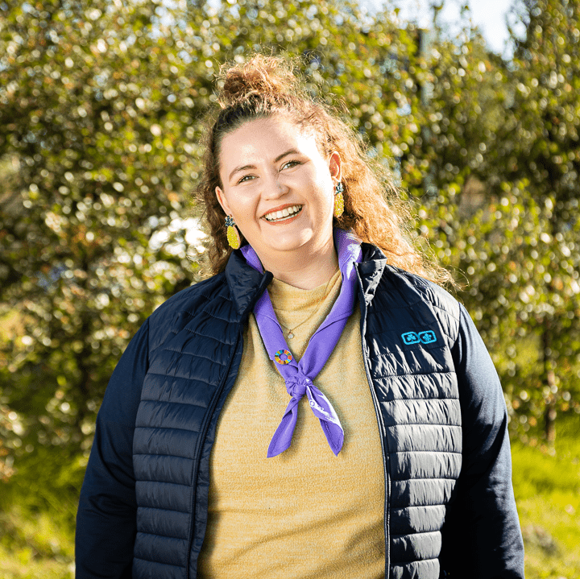
TODAY
SUSTAINABLE EVENTS
  Sustainability
  What we do
  Work together
  Discussions
Kolbrún Ósk
kolbrun@skatarnir.is
Notes:
There are three pillars of sustainable development: The social pillar, the environmental pillar, and the economic pillar. It is essential to take these three pillars equally into account while designing a sustainable development plan

Slide 3




Sustainability
ENVIRONMENTAL
Bearable
Viable
SUSTAINABLE
SOCIAL
ECONOMIC
Equitable
Notes:
There are three pillars of sustainable development: The social pillar, the environmental pillar, and the economic pillar. It is essential to take these three pillars equally into account while designing a sustainable development plan

Slide 4
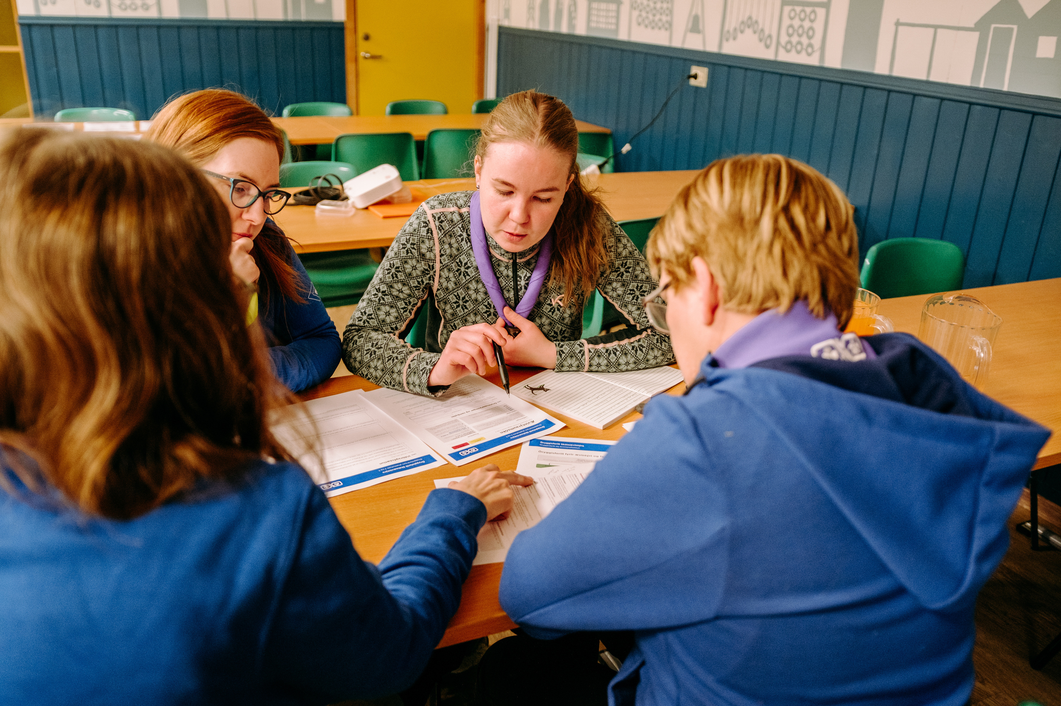
What we do
Check-lists
Making it accessible to the people hosting events
Putting it on our website to spread awareness
Notes:
Economic sustainability also involves creating economic opportunities that are accessible to all members of society, regardless of income or social status.

Slide 5
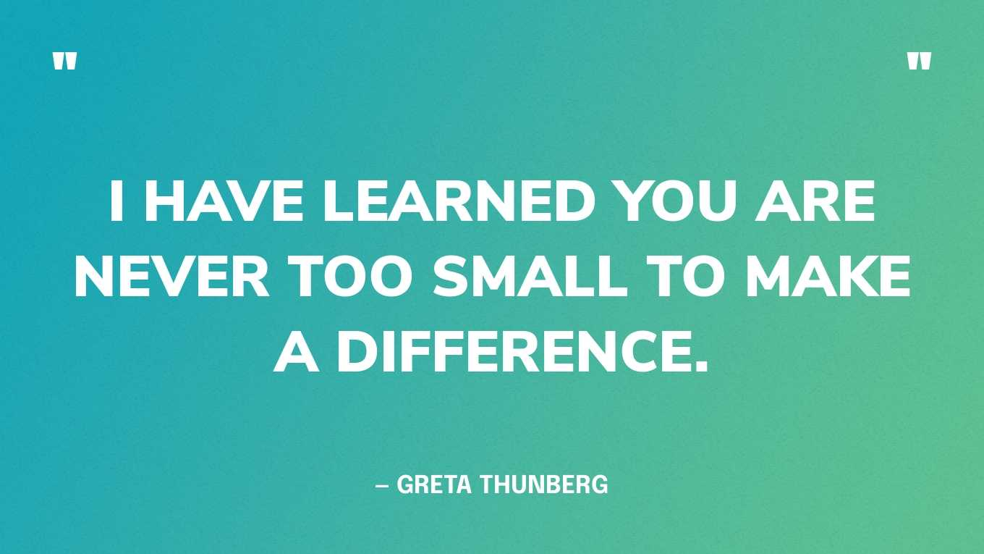

Slide 6
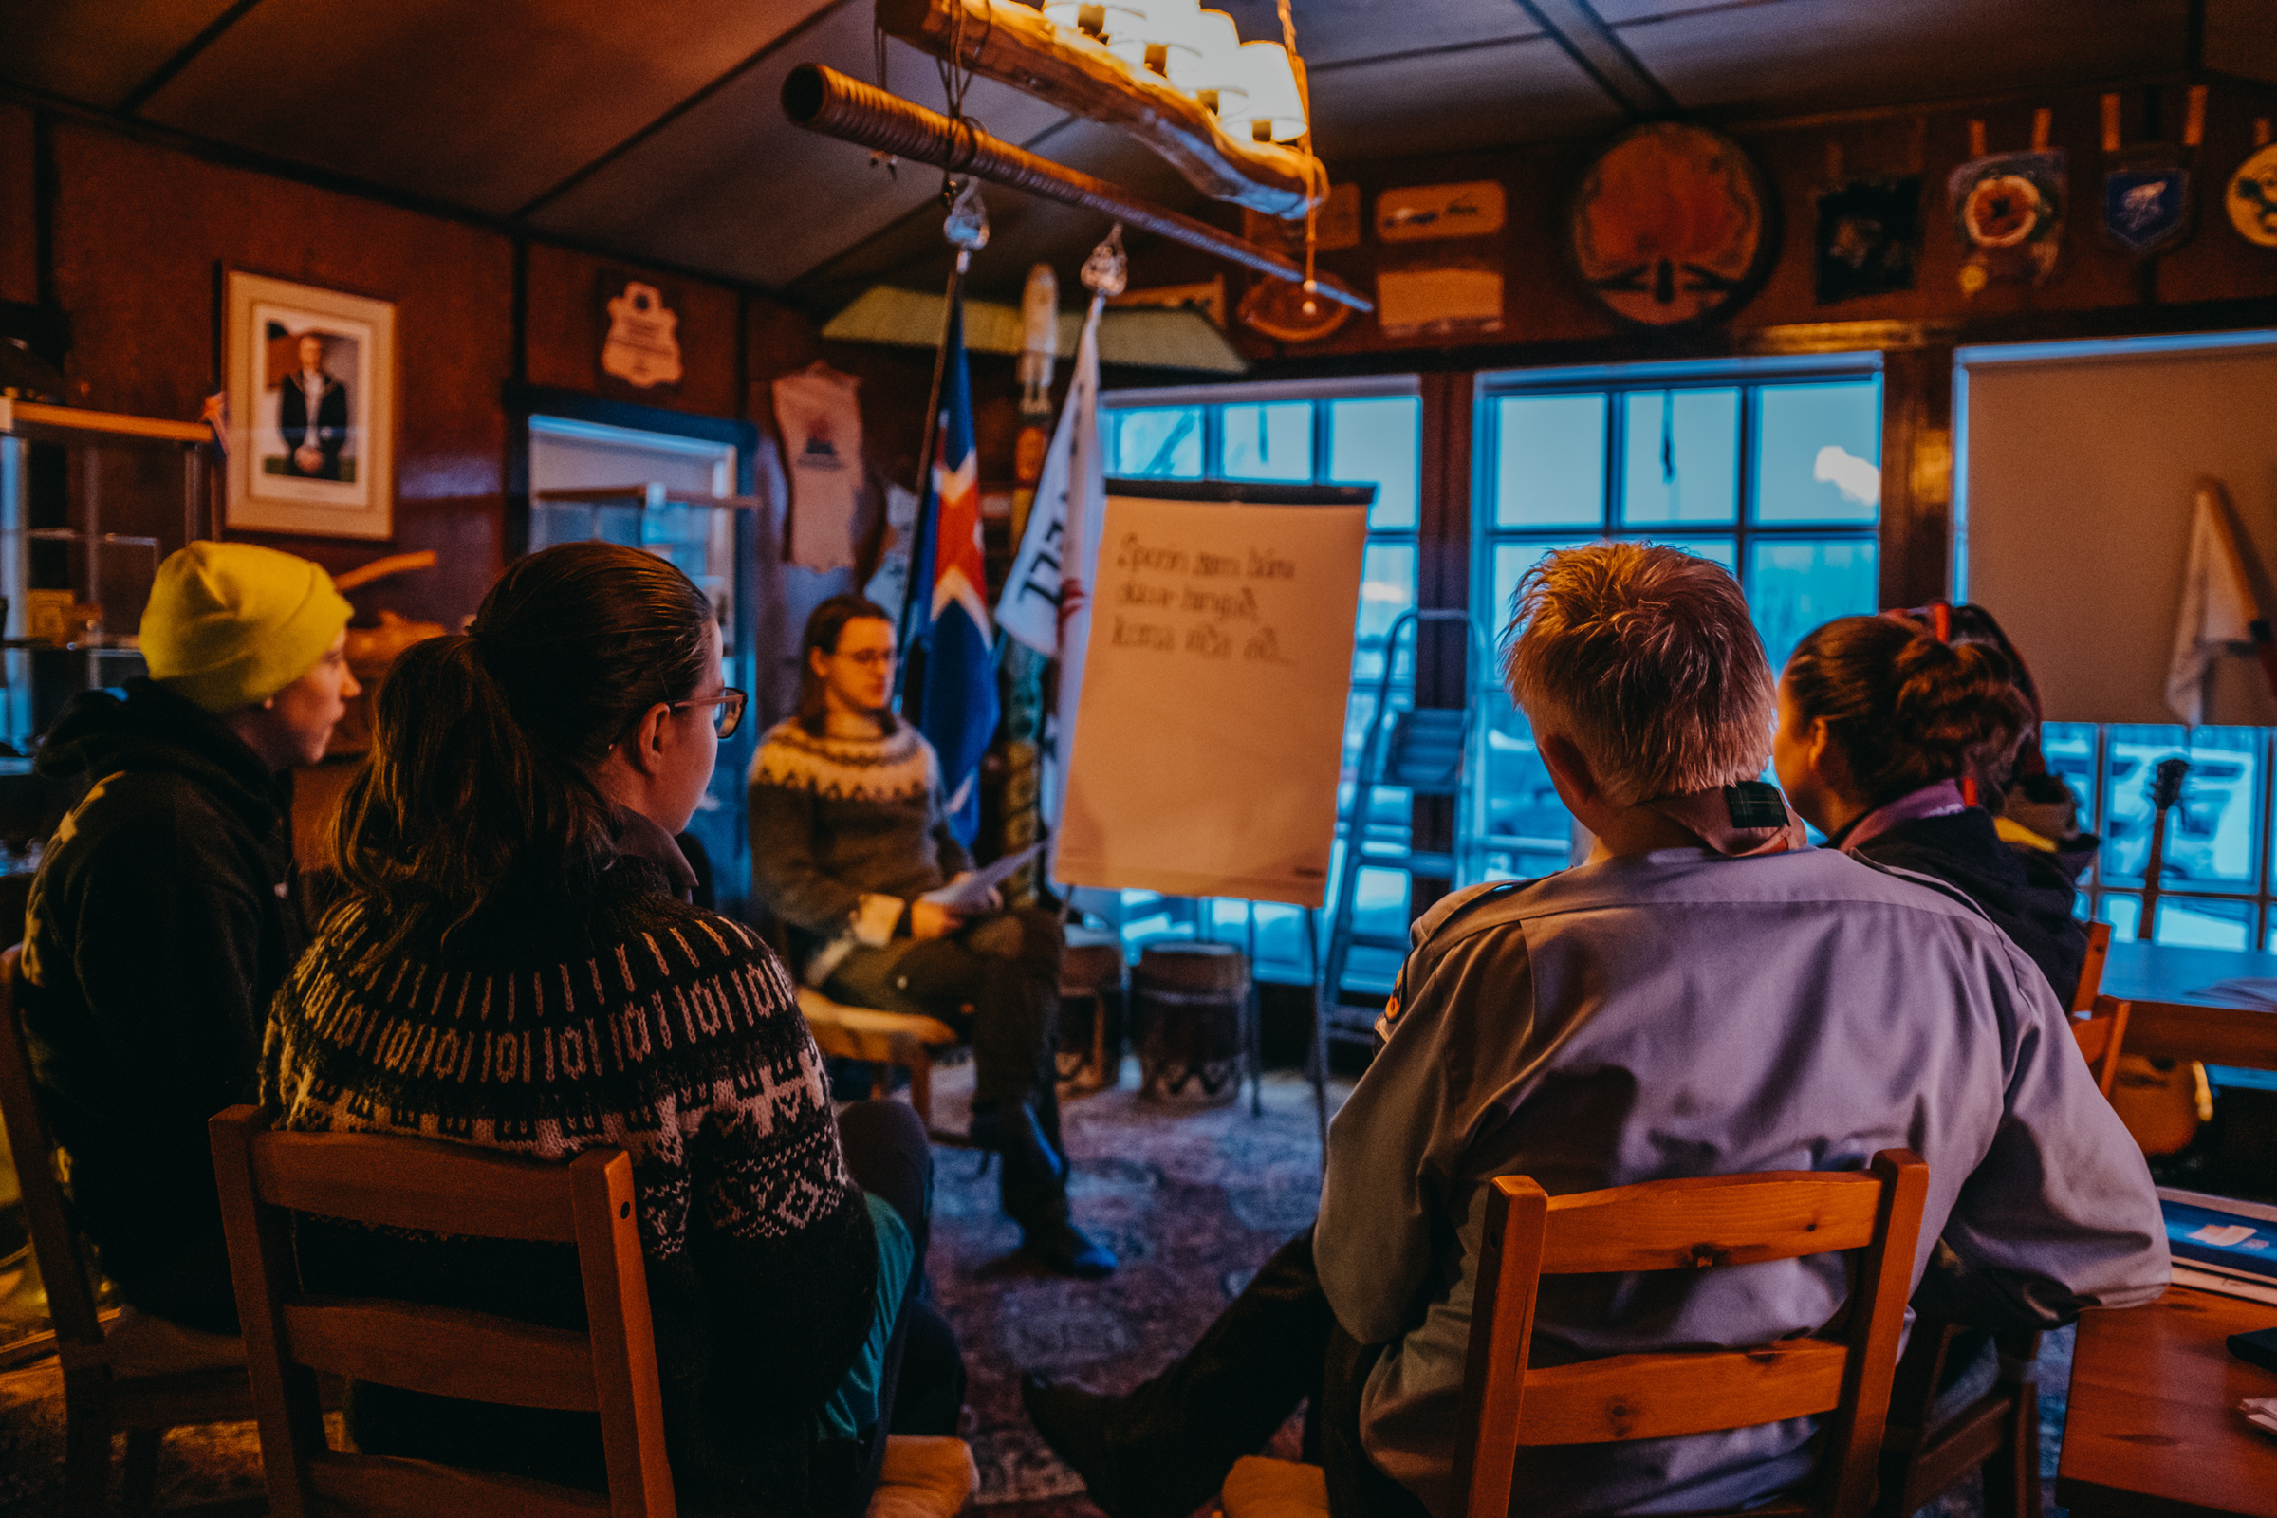
Presentations
from groups

Slide 7
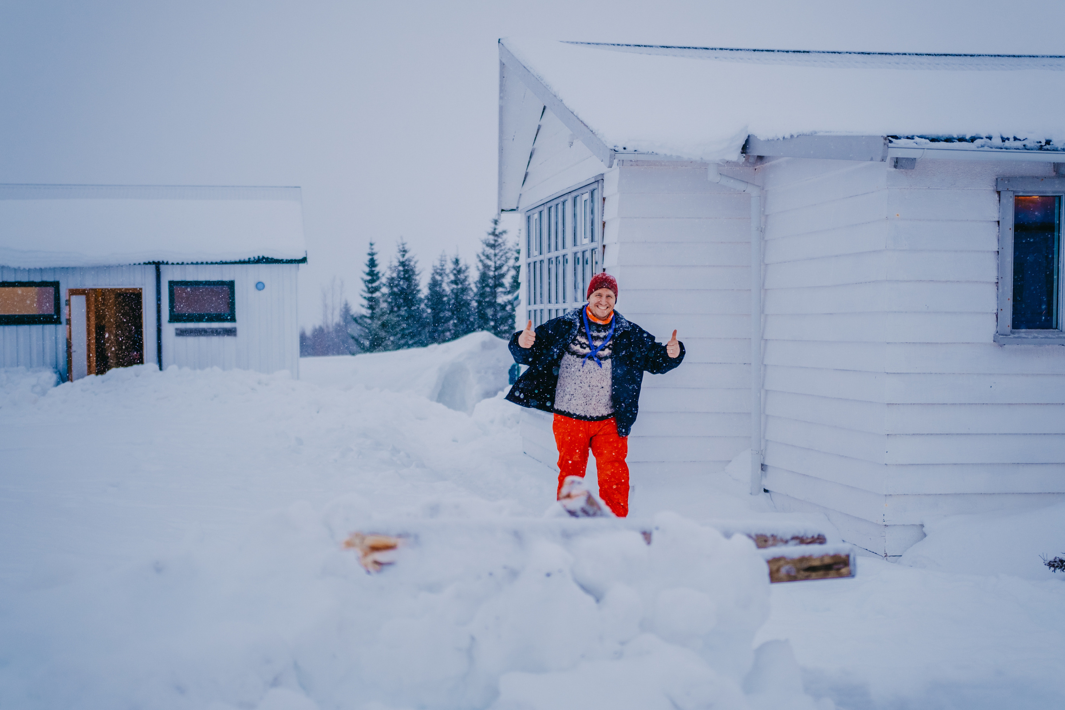
Thank you!

