Slide 1
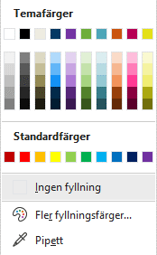
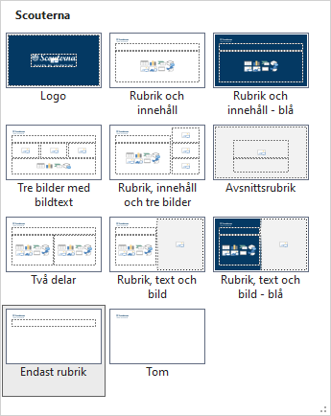
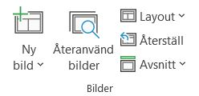
Instruktioner Dold sida, visas inte vid utskrift
Vad är en layout?
De fyra första är färger för text och bakgrund
Vad är temafärger?
Klistra in en sida från en annan mall
Layout kallas de olika designer på sidor som du kan hitta i din mall. Du hittar dem under knappen Layout i menyn.
När du vill byta layout på en sida
Temafärger är den färgpalett som är speciellt inställd för just din mall.
De sex färgerna till höger är era temafärger
Ja, dock följer layouten från den andra mallen med in i den nya mallen, och det kan bli förvirrande. Dessutom krävs det att sidan du ska klistra in gjorts på rätt sätt – dvs att korrekt platshållare använts till rätt typ av innehåll (det är en bra anledning till att alltid använda platshållare där det finns!). Vill du vara säker på att det blir rätt? Markera i så fall varje enskilt innehåll och klistra in var för sig.
Återställer en sidas layouts ifall du gjort egna ändringar
Visar samtliga layoutsidor
Office standardfärger. Använd inte dessa!

Slide 2
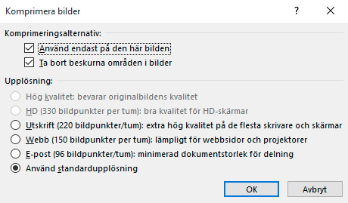
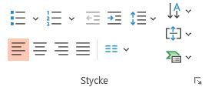
Instruktioner Dold sida, visas inte vid utskrift
Vad är format?
Hur komprimerar jag bilder?
Format kallas olika textformaten som finns i mallen – så som rubrik, underrubrik och de olika nivåerna i en punktlista. I mallen är de anpassade efter just era direktiv, så använd dem så som de är inställda.
För tunga bilder kan göra att din presentation laggar och blir långsam. Ta för vana att komprimera bilder så här:
Ställ dig på den bild du vill komprimera.
Välj Bildformat i menyn
I menyn finns valet Komprimera bilder. När du väljer det öppnas en dialogruta. Nu kan du göra dina val.
Punktlista nivå 1
Punktlista nivå 2
Punktlista nivå 3
Punktlista nivå 4
Viktigt!
När du väl komprimerat kan du inte återställa bilderna om du behöver, utan måste då klistra in dem på nytt
Klicka ur Använd endast på den här bilden om du vill komprimera alla bilder i din presentation
När du vill gå upp eller ned en nivå i en punktlista använder du Öka/Minska indrag. Dessa hittar
du här
Här väljer du vilken upplösning du vill komprimera till

Slide 4
Outline
Short check in
Intro from Finland
What did Sweden do?
About the certificate
Workshop!
Short check out

Slide 5
Sustainable Scouting Criteria
Criteria was created in 2020 together with WWF Finland to activate local groups to pursue more sustainable practices.
Consist of 50 sustainability criteria, in which local group must pass at least 25
Now 130 Local groups have the certificate
Sustainable action fund of Finnish Scouts has funded 73 local level projects during 2022-2024. The purpose of the fund is to support local groups developing their sustainability work.
Notes:
Consists of 10 adult (over 22) voluntary scout leaders who combined spend approximately 40-50 hours a month working on sustainability initiatives in co-operation with the other scout volunteers across the organisation
All team members are volunteers. In addition their employee of central organization
The group is also supported by an advisory board that consists of 10 experts from universities, research institutes and government. They all donate their time (approx 45h / year) to the cause.

Slide 6
accessibility
Environmental education
sustainable food choices
traveling
recycling
energy and water use
Notes:
Consists of 10 adult (over 22) voluntary scout leaders who combined spend approximately 40-50 hours a month working on sustainability initiatives in co-operation with the other scout volunteers across the organisation
All team members are volunteers. In addition their employee of central organization
The group is also supported by an advisory board that consists of 10 experts from universities, research institutes and government. They all donate their time (approx 45h / year) to the cause.

Slide 7
The process of applying for the certificate
A local group goes through the criteria together
The application is submitted electronically.
The sustainability group reviews the application
The certificate is valid for 2 years, and after that the certificate needs to be reapplied
It is recommended for local groups to fill more criteria in the next application round but not mandatory.
Notes:
Consists of 10 adult (over 22) voluntary scout leaders who combined spend approximately 40-50 hours a month working on sustainability initiatives in co-operation with the other scout volunteers across the organisation
All team members are volunteers. In addition their employee of central organization
The group is also supported by an advisory board that consists of 10 experts from universities, research institutes and government. They all donate their time (approx 45h / year) to the cause.

Slide 8
It's time for more challenge!
The certificate is being updated this year
The first groups will apply for the certificate for the third time next year. In this point we want offer groups more challenge
We want the certificate to notice better the sustainability related to sea scouting. Also the criteria of accessibility and social impact are updated
Other ideas how the certificate should be updated? Please tell us!
Notes:
Consists of 10 adult (over 22) voluntary scout leaders who combined spend approximately 40-50 hours a month working on sustainability initiatives in co-operation with the other scout volunteers across the organisation
All team members are volunteers. In addition their employee of central organization
The group is also supported by an advisory board that consists of 10 experts from universities, research institutes and government. They all donate their time (approx 45h / year) to the cause.

Slide 9
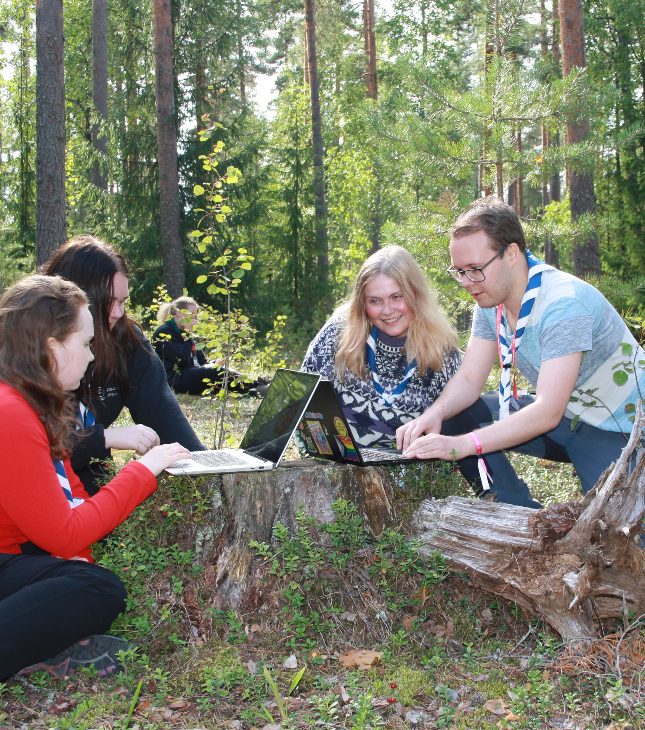
Carbon footprint calculators
Scout carbon footprint calculators were created last year. Can be used to calculate footprint of events, trips, camps or a year footprint of a district/local group
Trainings to use the tools are organized at the moment
Next step: setting targets to decrease carbon footprints to all big events
Carbon footprint measuring will be also added to sustainability certificate
Notes:
Consists of 10 adult (over 22) voluntary scout leaders who combined spend approximately 40-50 hours a month working on sustainability initiatives in co-operation with the other scout volunteers across the organisation
All team members are volunteers. In addition their employee of central organization
The group is also supported by an advisory board that consists of 10 experts from universities, research institutes and government. They all donate their time (approx 45h / year) to the cause.

Slide 10
Notes:
Consists of 10 adult (over 22) voluntary scout leaders who combined spend approximately 40-50 hours a month working on sustainability initiatives in co-operation with the other scout volunteers across the organisation
All team members are volunteers. In addition their employee of central organization
The group is also supported by an advisory board that consists of 10 experts from universities, research institutes and government. They all donate their time (approx 45h / year) to the cause.

Slide 11
Sustainability in Youth program
Notes:
Consists of 10 adult (over 22) voluntary scout leaders who combined spend approximately 40-50 hours a month working on sustainability initiatives in co-operation with the other scout volunteers across the organisation
All team members are volunteers. In addition their employee of central organization
The group is also supported by an advisory board that consists of 10 experts from universities, research institutes and government. They all donate their time (approx 45h / year) to the cause.

Slide 12
Other things
Sustainable events –guidelines
Carbon neutral Scouting
Carbon footprint calculator
Carbon handprint
Travelling guidelines for sustainable travelling

Slide 13
Part of our sustainability project
Funded by Swedish Association of Outdoor Organizations
Hållbar Scoutkår (the certificate) is ONE part of the project
On a strategic level: sustainability reports, guidelines and policies, new strategy, collaborations
On an operational level: the certificate, share best practices, trainings, inspiration
Notes:
Projektet är på 2 år, men vi hoppas såklart att detta är starten på något längre och varaktigt.

Slide 14
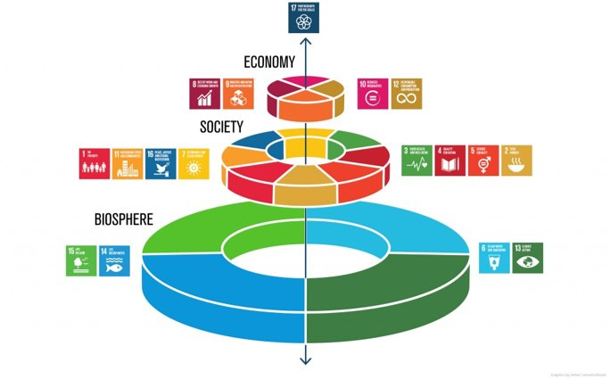
Focus on environmental sustainability​
Notes:
Scouterna har kommit ganska långt inom social hållbarhet (även om vi fortfarande kan göra mer) med projekt inom t.ex. psykisk hälsa, Trygga Möten, inkludering och tillgänglighet på olika sätt. Vi tror att vi kan göra lika stort skillnad inom miljömässig hållbarhet. Därför kommer det här projektet har fokus på den området, även om allting hänger ihop! För att bli bättre på miljön måste vi t.ex. också konsumera på ett mer hållbart sätt.

Slide 15
Background
Increased interest and engagement from our members
Requests from others
Big need in society
Good role models
Live as we teach
Notes:
Våra effektmål handlar mycket om att skapa en känsla av tilltro till sin egen förmåga, engagemang och gemenskap kring de här frågorna. Det ska vara tydligt, enkelt och fungera i alla led. Hållbarhet ska vara något som vi kan, vi gör tillsammans och det blir skillnad på riktigt. Mindre ångest och mer stolthet!

Slide 16
Aim and goals
More environmentally friendly organization
More knowledge among leaders
Canalize the engagement
More fun!
A common ground
Self esteem
Pride and commitment
Notes:
Syftet mer projekt är därför följande. Göra vår verksamhet mer hållbar, involvera våra unga scouter, stötta våra ledare och göra allt mer lustfyllt. I detta ingår att även lyfta upp allt bra som redan görs, för att inspirera andra och heja på!

Slide 17
Leaders and adults
One of our target groups
Asking for more tools and methods
Need more knowledge
Should feel proud, committed and a sense of "we got this"
More action, less talk (verkstad!)
Hållbar Scoutkår!

Slide 18
The certificate
Thankful to Finland <3
Our own logo and somewhat translated to our organization and structure
The website
The tools
A guideline for everyone!
Both environment, social and economical
The diploma and the local websites

Slide 19
Challenges and sucess
11 local groups so far
A few comments on the criteria
We need to reach out more!
Positive feedback
Automatic adminstration
Well used tool in Finland
We can focus on communication and engagement!
Notes:
118 kårer i Finland. Länk till hemsidan. Visa diplomet!
Hur kommer det att se ut på webben?
Var kommer detta ifrån?
Hur går det till rent praktiskt? Visa filmen.
Vad händer sen?

Slide 21
Thank you for participating!
Contact details Finland
Sweden
Cecilia Wesslén, sustainability manager
Cecilia.wesslen@scouterna.se
Mikael Stark, project manager
Mikael.stark@scouterna.se
QR kod!

