Slide 1
Making and Implementing of Sustainability Policy
Thomas Frankel Goul & Erik Korup Pedersen
Members of the National Board, DDS
Nordisk Spejderkonference 2024

Slide 2
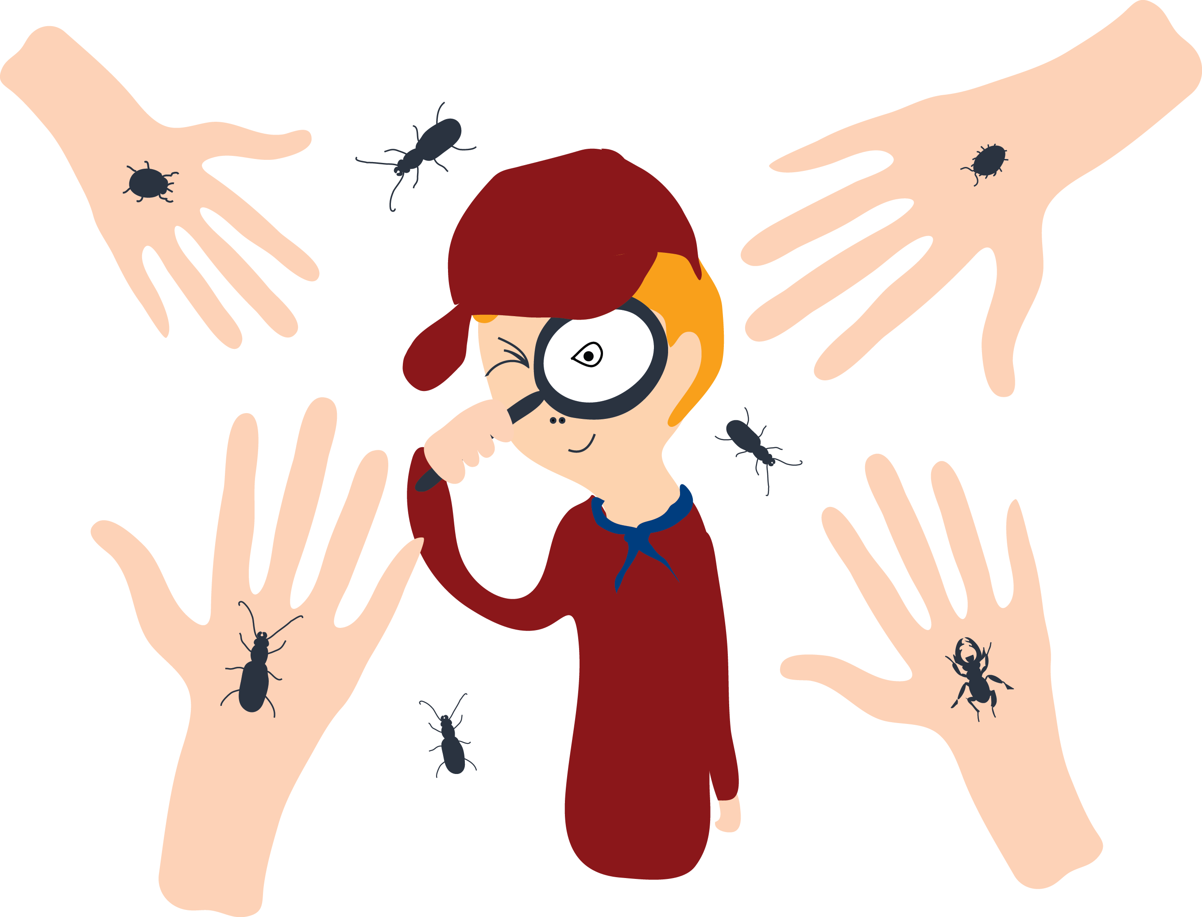
Program
Introduction
Our work making sustainability policy
Our efforts at an organizational level
Our local groups driving change
Group discussions

Slide 3
Creating policy

Slide 4
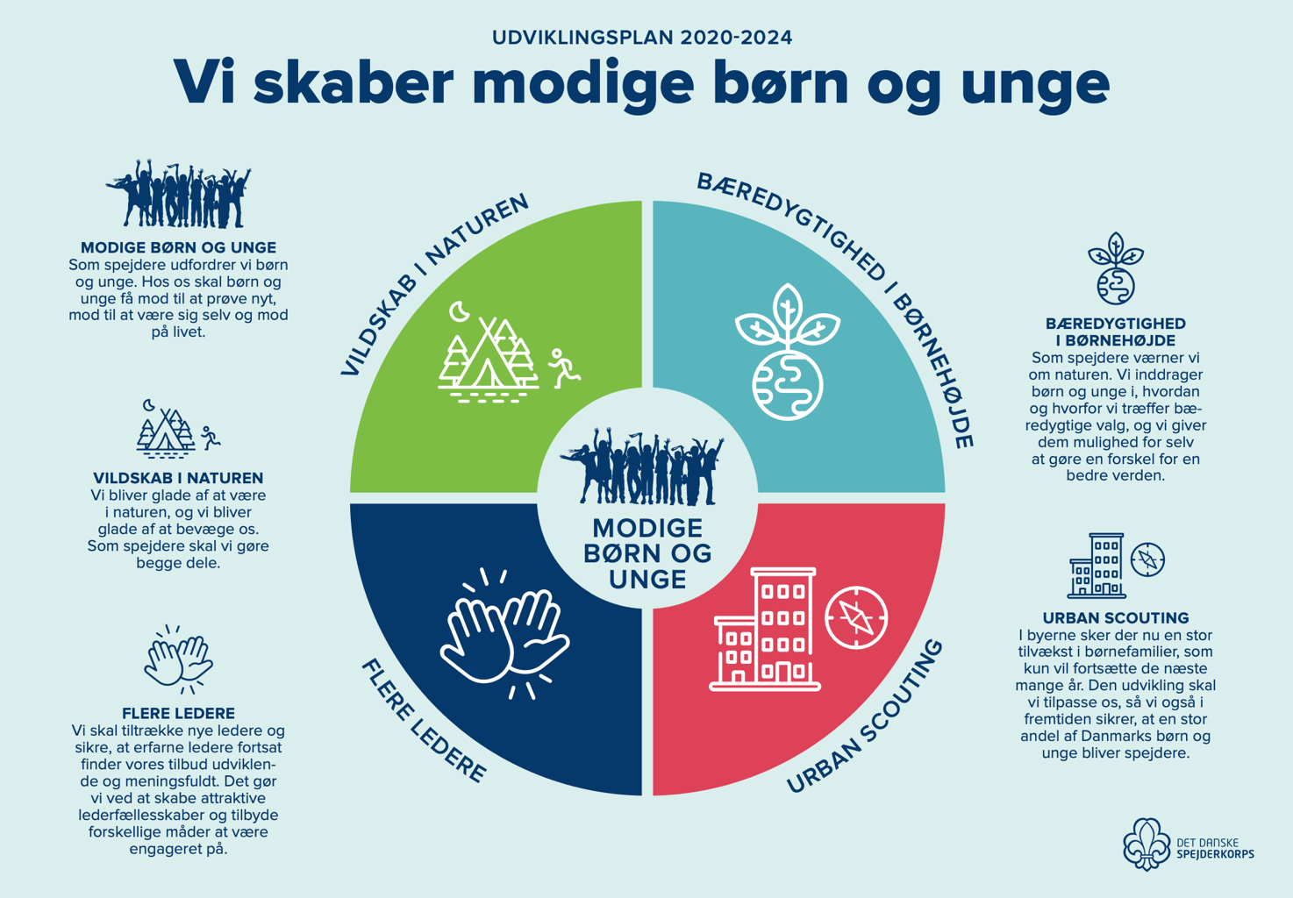
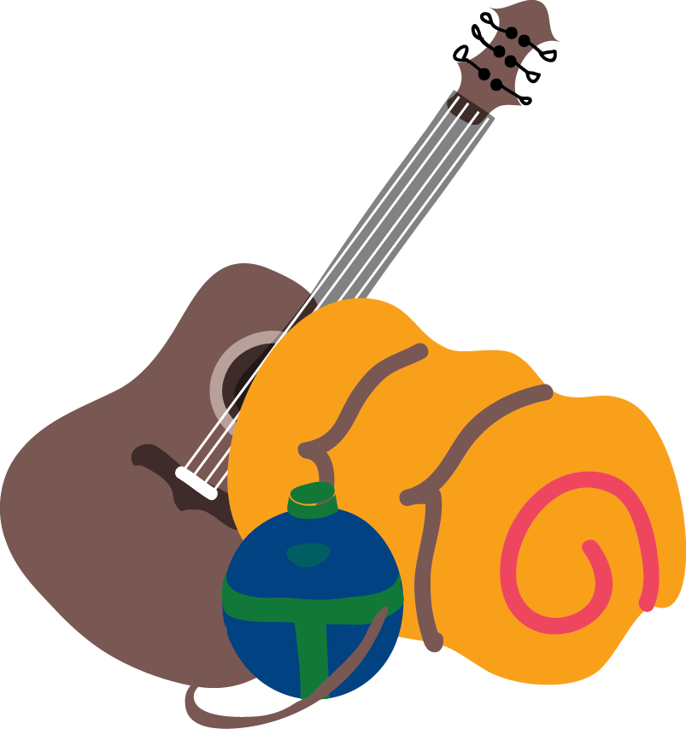
Notes:
Why do we need to work with sustainabilty? – 2024 Vision
Creating brave children and youth
Co-existing in nature
Sustainability for kids
More scout leaders
Urban scouting

Slide 5
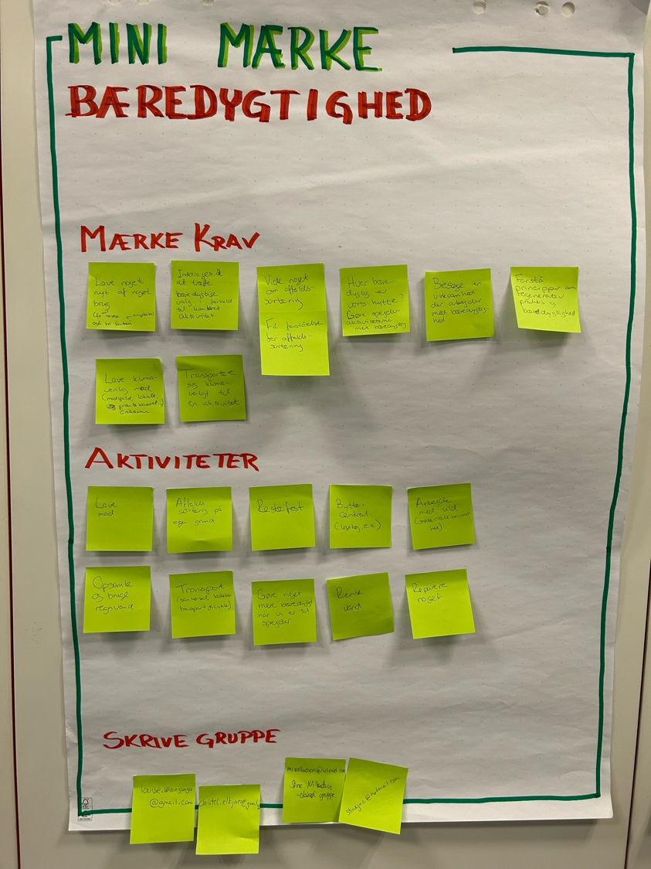
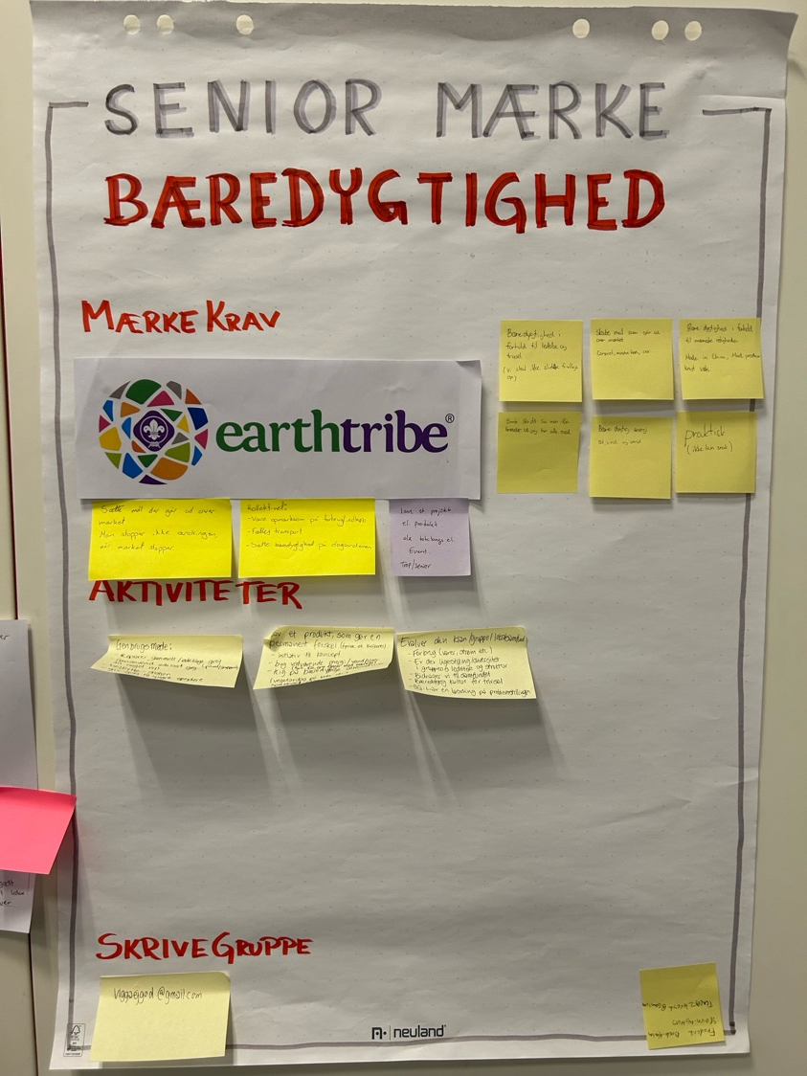
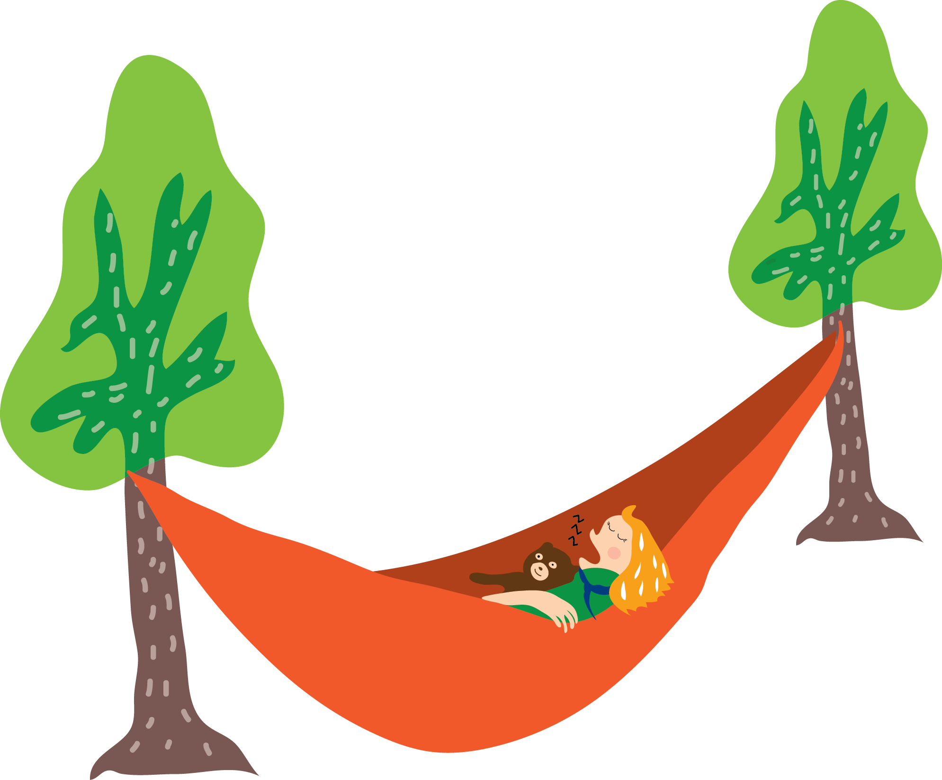
Process leading up to our policy work
Primarily office driven
Workshop at our GA with input from our members
Online webinars and open calls for participation
Where can we create an impact?

Slide 6
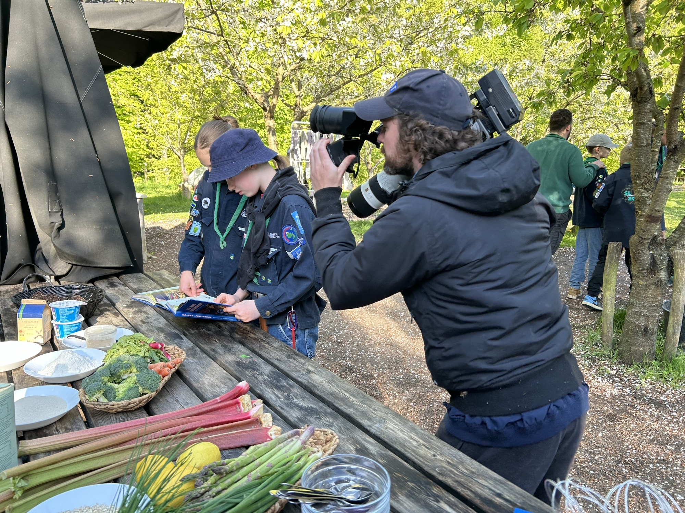
Questions that were raised
”Has to” or ”should”?
Should the policy affect central organization or all local groups?
Not good enough public transportation etc.

Slide 7
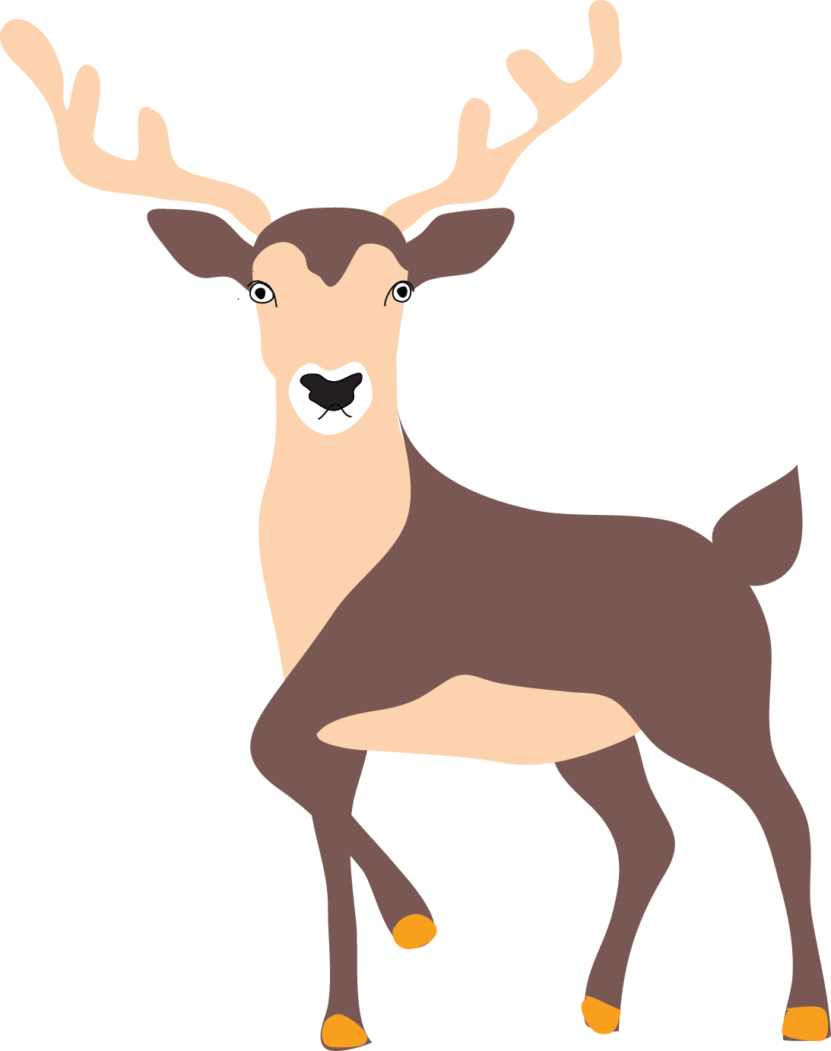
Sustainability policy
Notes:
We made a sustainability policy which dictates that:
We act and actively take a stand on our consumption.
We seek understanding of nature and how we best protect it
We take decisive action with curiosity and optimism

Slide 8
Going from policy to guidelines and inspiration
Notes:
Policies are general and broad, but how do we make living up to them possible?
To help our leaders live up to our sustainability policy, we made a more specific guide.
This can make it easier to live up to the policy and create real action.
It is basically a list of things we could do differently when doing scouting to become more sustainable

Slide 9
Implementing change
Making action out of policy
Notes:
First we did the paperwork – but how do we make it work out in our local units?
We want to give you a short overview of our efforts nationally and locally.

Slide 10
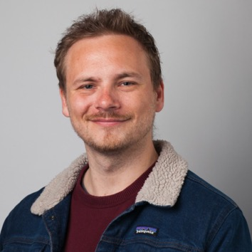
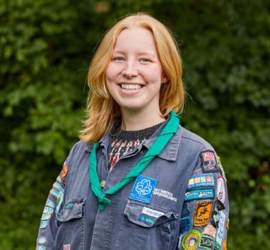
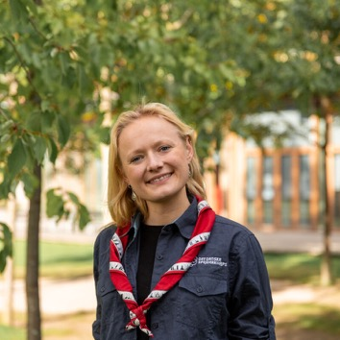
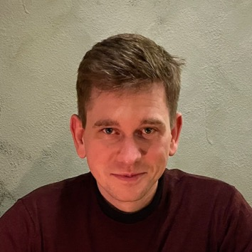
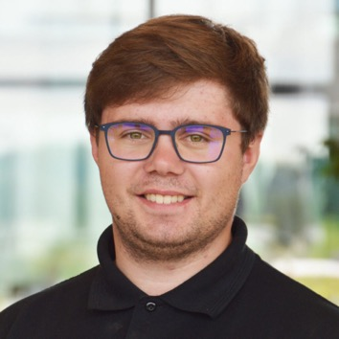
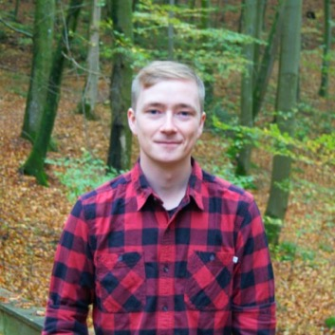
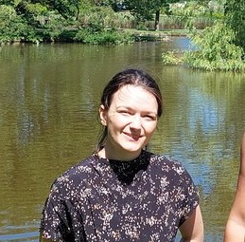
Advisory Board for our sustainability work
Notes:
Our offices has created an advisory board for our sustainability work with *mostly* young members with different relevant backgrounds, in engineering, sustainability and so on.
These people help our consultant Tobias create the best possible projects for our organization.

Slide 11
Membership of the Danish sustainable thinktank
Notes:
We also have entered into the danish sustainability thinktank Concito, where we support their work at a national level.

Slide 12
Cookbook in sustainable cooking
– in a scouting setting
Notes:
Cookbook in sustainable cooking – primarily plant based.
Meant for cooking over a fire – easy to do at home as well.
Easy recipies with in-season food.
Book released april 9th, almost sold out in our stores already.

Slide 13
Programme work
Sustainability and sustainable food
Notes:
We are also working on programme in ‘green’ food and also sustainability. Here you see our new – not yet released – badges for different age groups working with sustainable food.

Slide 14
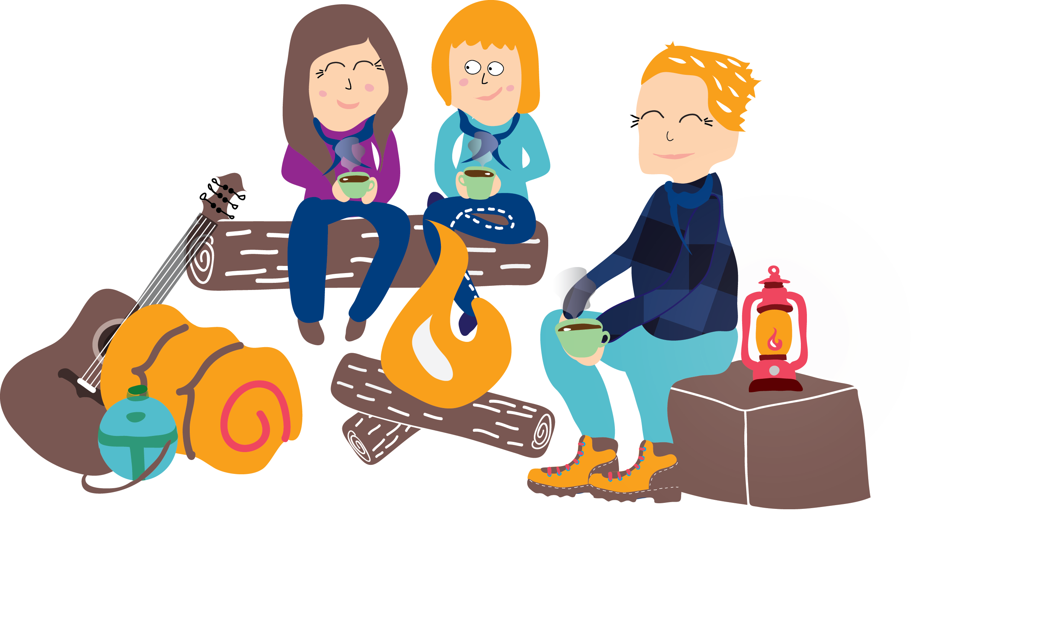
Volunteer efforts driving change
”The Green Avantgarde” – local groups leading change
Local classes in sustainable food for scouting with upwards of 300 participants
Public debate and civil society participation from our members
Notes:
We have seen a large trickle-down-effect from our efforts at a national level.
A sign-up group of
Local groups running large classes in sustrainable cooking all over the country.
Youth-Climate board in the ministry of climate affairs

Slide 15
Group discussions
Notes:
How does your NSA work with sustainability?
What does sustainability mean in a scouting context to your NSA?
What one contribution TILTAG has created the most impact in your NSA, civil society or towards nature?
What challenges do/did your NSA face when working with sustainability? – and what could you improve?

Slide 16
How does your NSA work with sustainability?
Notes:
How does your NSA work with sustainability?
What does sustainability mean in a scouting context to your NSA?
What one contribution TILTAG has created the most impact in your NSA, civil society or towards nature?
What challenges do/did your NSA face when working with sustainability? – and what could you improve?

Slide 17
What does sustainability in a scouting context mean to your NSA?
Notes:
How does your NSA work with sustainability?
What does sustainability mean in a scouting context to your NSA?
What one contribution TILTAG has created the most impact in your NSA, civil society or towards nature?
What challenges do/did your NSA face when working with sustainability? – and what could you improve?

Slide 18
What one contribution has created the most impact in your NSA, civil society or towards nature?
Notes:
How does your NSA work with sustainability?
What does sustainability mean in a scouting context to your NSA?
What one contribution TILTAG has created the most impact in your NSA, civil society or towards nature?
What challenges do/did your NSA face when working with sustainability? – and what could you improve?

Slide 19
What challenges do/did your NSA face when working with sustainability? – and what could you improve?
Notes:
How does your NSA work with sustainability?
What does sustainability mean in a scouting context to your NSA?
What one contribution TILTAG has created the most impact in your NSA, civil society or towards nature?
What challenges do/did your NSA face when working with sustainability? – and what could you improve?

Slide 20
Final thoughts?

