Slide 1
A HISTORY OF SAFEGUARDING

Slide 2
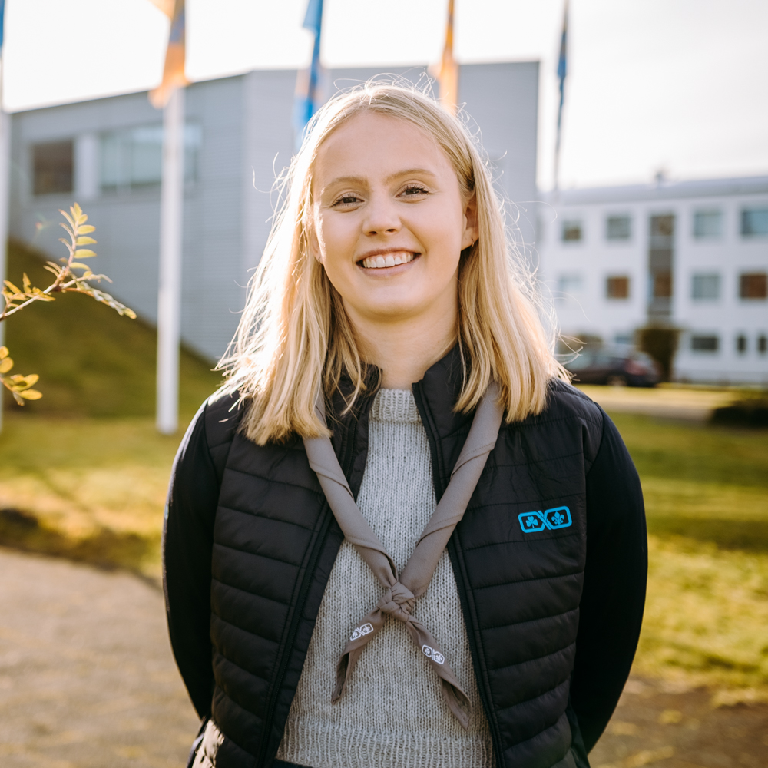
TODAY
Icelandic legislation
The Icelandic Youth Forum
Response plan
How do we implement it?
Challenges we’re facing
Katrín Kemp Stefánsdóttir katrin@skatarnir.is

Slide 3
WHAT IS SAFEGUARDING?

Slide 4
ICELANDIC LEGISLATION
YOUTH ACT NR. 70/2007

Slide 5
YOUTH ACT NR. 70/2007
Article 10, paragraph 1
Those working with or in charge of children and young people in youth activities should, as a
general rule, be legally of age and possess the necessary training, education, knowledge or
experience for the job.

Slide 6
YOUTH ACT NR. 70/2007
Article 10, paragraph 2
Group leaders, instructors, volunteers and other staff are prohibited from consuming alcohol
or other intoxicating substances during organised youth activities and while on trips with children
or young people.

Slide 7
YOUTH ACT NR. 70/2007
Article 10, paragraph 3
It is illegal to hire individuals for youth work who have been found guilty of sex crimes or of breaking laws about alcohol- and drugs within the last five years. The same goes for those who are hired as volunteers.

Slide 8
YOUTH ACT NR. 70/2007
Article 10, paragraph 4
Directors in youthwork thus have the right to seek information from the criminal record of individuals who have applied for jobs with them with their permission.

Slide 9
ICELANDIC LEGISLATION
YOUTH ACT NR. 70/2007
CHILD PROTECTION ACT NR. 80/2002

Slide 10
CHILD PROTECTION ACT NR. 80/2002
Article 1, paragraph 1 & 2
Children have the right to protection and care. They shall enjoy rights according to their age and maturity.
All those who are responsible for the upbringing and care of children shall show them respect and kindness and are completely unauthorized to use violence or other disrespectful methods on them.

Slide 11
CHILD PROTECTION ACT NR. 80/2002
Article 1, paragraph 17
All those who deal with matters of children because of their occupation or position and is aware that a child lives in unacceptable conditions for upbringing, is exposed to violence or other untolerable behavior or that a child’s health or development is being severely compromised is obliged to report it to children’s protections services.
The duty of notification provided in this Article takes precedence over provisions in law or codes
of ethics on confidentiality within the relevant professions

Slide 12
ICELANDIC LEGISLATION
YOUTH ACT NR. 70/2007
CHILD PROTECTION ACT NR. 80/2002
ACT ON EQUAL STATUS AND EQUAL RIGHTS IRRESPECTIVE OF GENDER NR. 150/2020

Slide 13
ACT ON EQUAL STATUS AND EQUAL RIGHTS IRRESPECTIVE OF GENDER NR. 150/2020
Article 14, paragraph 1
Employers and the directors of institutions, civil society organisations and sports and youth
organisations shall take special measures to protect their employees, students and clients from
gender-based violence, gender-based harassment or sexual harassment in the workplace or
institution, social activities or schools.

Slide 16
Supports communication between the associations.
Has made:
Code of ethics and personal conduct
Courses on
Child protection
Communications and code of ethics
Hate speech
Multi- culturalism and inclusivity
Etc.

Slide 17
Supports communication between the associations.
Has made:
Code of ethics and personal conduct
Courses on
Child protection
Communications and code of ethics
Hate speech
Multi- culturalism and inclusivity
Etc.

Slide 18
CODE OF ETHICS AND PERSONAL CONDUCT

Slide 19
CODE OF ETHICS AND PERSONAL CONDUCT
2010
The NSA starts drafting the first edition
2011
The code is finalized in coalition with Æskulýðsvettvangurinn
2013
The code is revised again
2013
The general assembly codifies them as NSA guidelines
2018
The code is revised again
2022
The code is certefied as part of the NSA bylaws
2022
The code is revised again
2023
ÆV general meeting certifies recent changes

Slide 20
BÍS BYLAWS
ARTICLE 2 - MEMBERSHIP TO BÍS
BÍS is a member association of the Icelandic Youth Forum and follows the rules, policies and response plan that the Icelandic Youth Forum imposes at any given time.
-Passed on the 2nd of April 2022

Slide 21
RESPONSE PLAN

Slide 23
RESPONSE PLAN
2010
The NSA starts drafting the first edition
2011
The first edition is published
2013
First revision
2015
Second revision
2018
The plan becomes the joint plan of Æskulýðsvettvangurinn
2020
Supposed to be revised again
2020
The embassy of Sports and Youth Activities Communication Counselor forms a taskforce to make a joint plan.
2022
The joint plan is published

Slide 24
CURRENT RESPONSE PLAN
Ladder of reporting
Children protection abuses
Disciplinary violations
Substance abuse
Violence
Bullying and communication problems
LGBTQIA+
Multiculturalism & inclusivity
Mental health
Illnesses & common diseses
Injuries
Death
Trauma outside of NGO
Safety
Trips & overnight stays
Natural disaster
Media communications
Documentation

Slide 25
IMPLEMENTATION
WHAT DO WE DO AND HOW

Slide 26
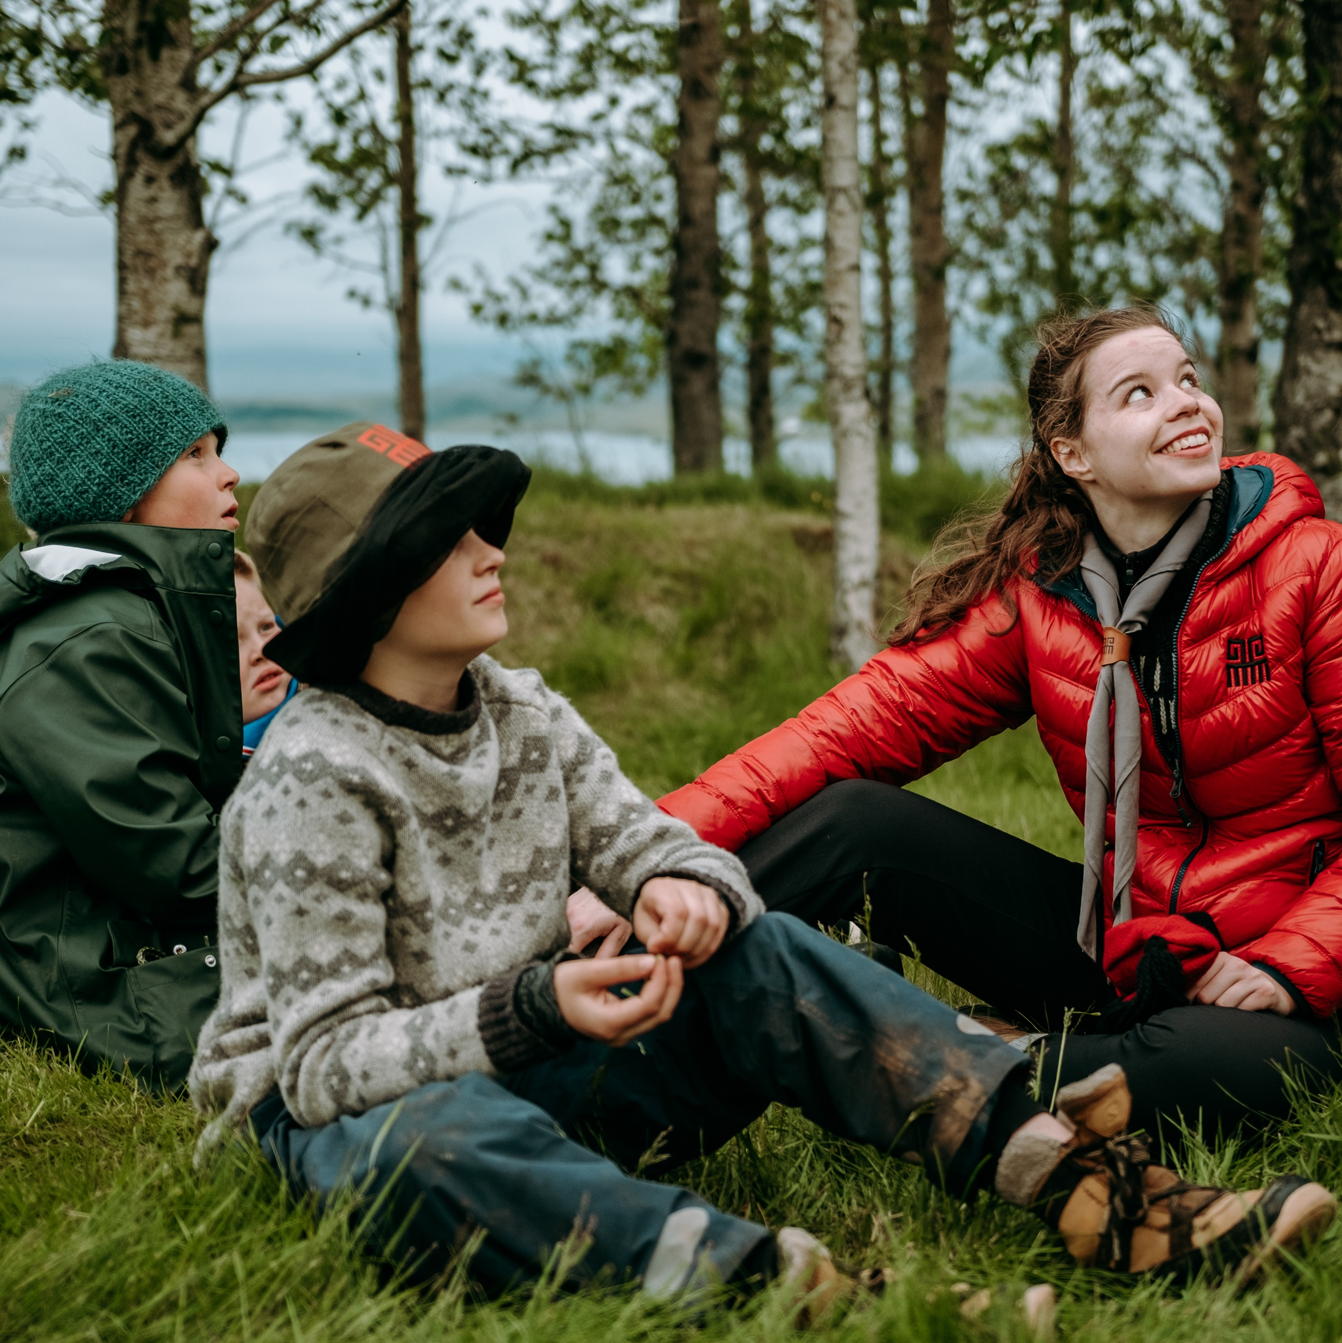
TRAINING
NUMBER 1, 2 & 3!
All staff and volunteers
ÚSÚ staff every 3 months
Summer staff
Included in leadership training
Courses from the Icelandic Youth Forum

Slide 27
VERNDUM ÞAU
A COURSE ON CHILD PROTECTION

Slide 28
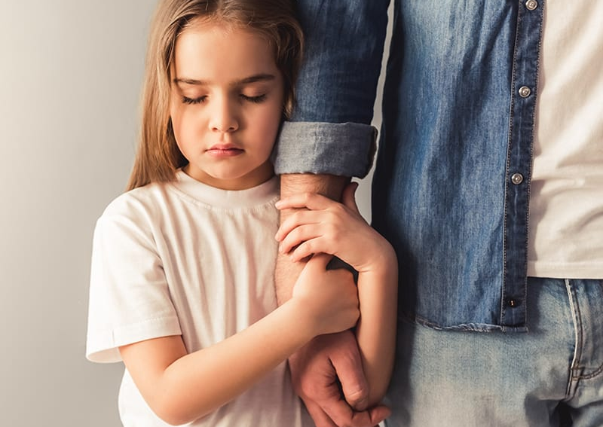
VERNDUM ÞAU
Started 13 years ago
Based on a handbook by specialists
4 hour mandatory course for all volunteers and employees
Scouts and YMCA started as the only participants in the course
Has been supplemented by an online course
Notes:
Minnast á hvað Barnahús er
Tala um hvernig það sé farið yfir eðlismun milli aldursflokka

Slide 29
SAMSKIPTI OG SIÐAREGLUR
A COURSE ON CODE OF ETHICS

Slide 30
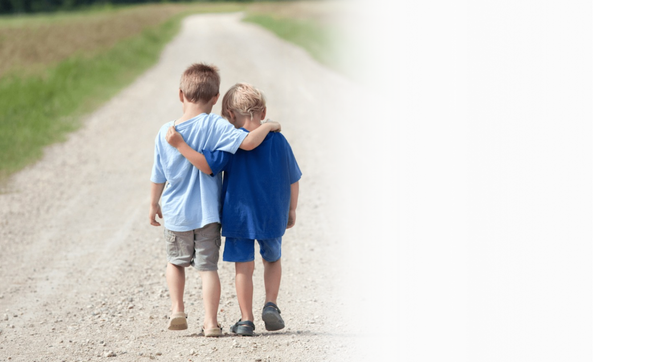
SAMSKIPTI OG SIÐAREGLUR
3 hour course for all volunteers and employees
Instigated by Scouts
Includes problem solving scenarios
Has been supplemented by an online course

Slide 31
EXAMPLE
You notice that one of the other volunteers uses nicotine pouches while managing program activities for a school group.
What code of conduct should they read again?

Slide 32
CRIMINAL RECORD CHECK

Slide 33
WHAT THE CHECK ENTAILS
Clause from the Youth Act nr. 70/2007
Further offenses, such as:
homicide, bodily harm and child protection
Allowing us to store the information in a closed system
Allowing us to notify the scout group if there is something

Slide 34
CRIMINAL RECORD CHECK

Slide 35
BYLAWS ON CRIMINAL CHECKS
Two motions have been carried and passed about criminal records checks at our General Assembly
All individuals 18 years and above regardless of their role or involvement with scouting need to turn in the form.
The return of forms for all individuals within a scout group is conditional for groups to recieve their votes at the general assembly.
Both motions were carried by the grassroot and not by NSA directors.

Slide 36
CHALLENGES

Slide 37
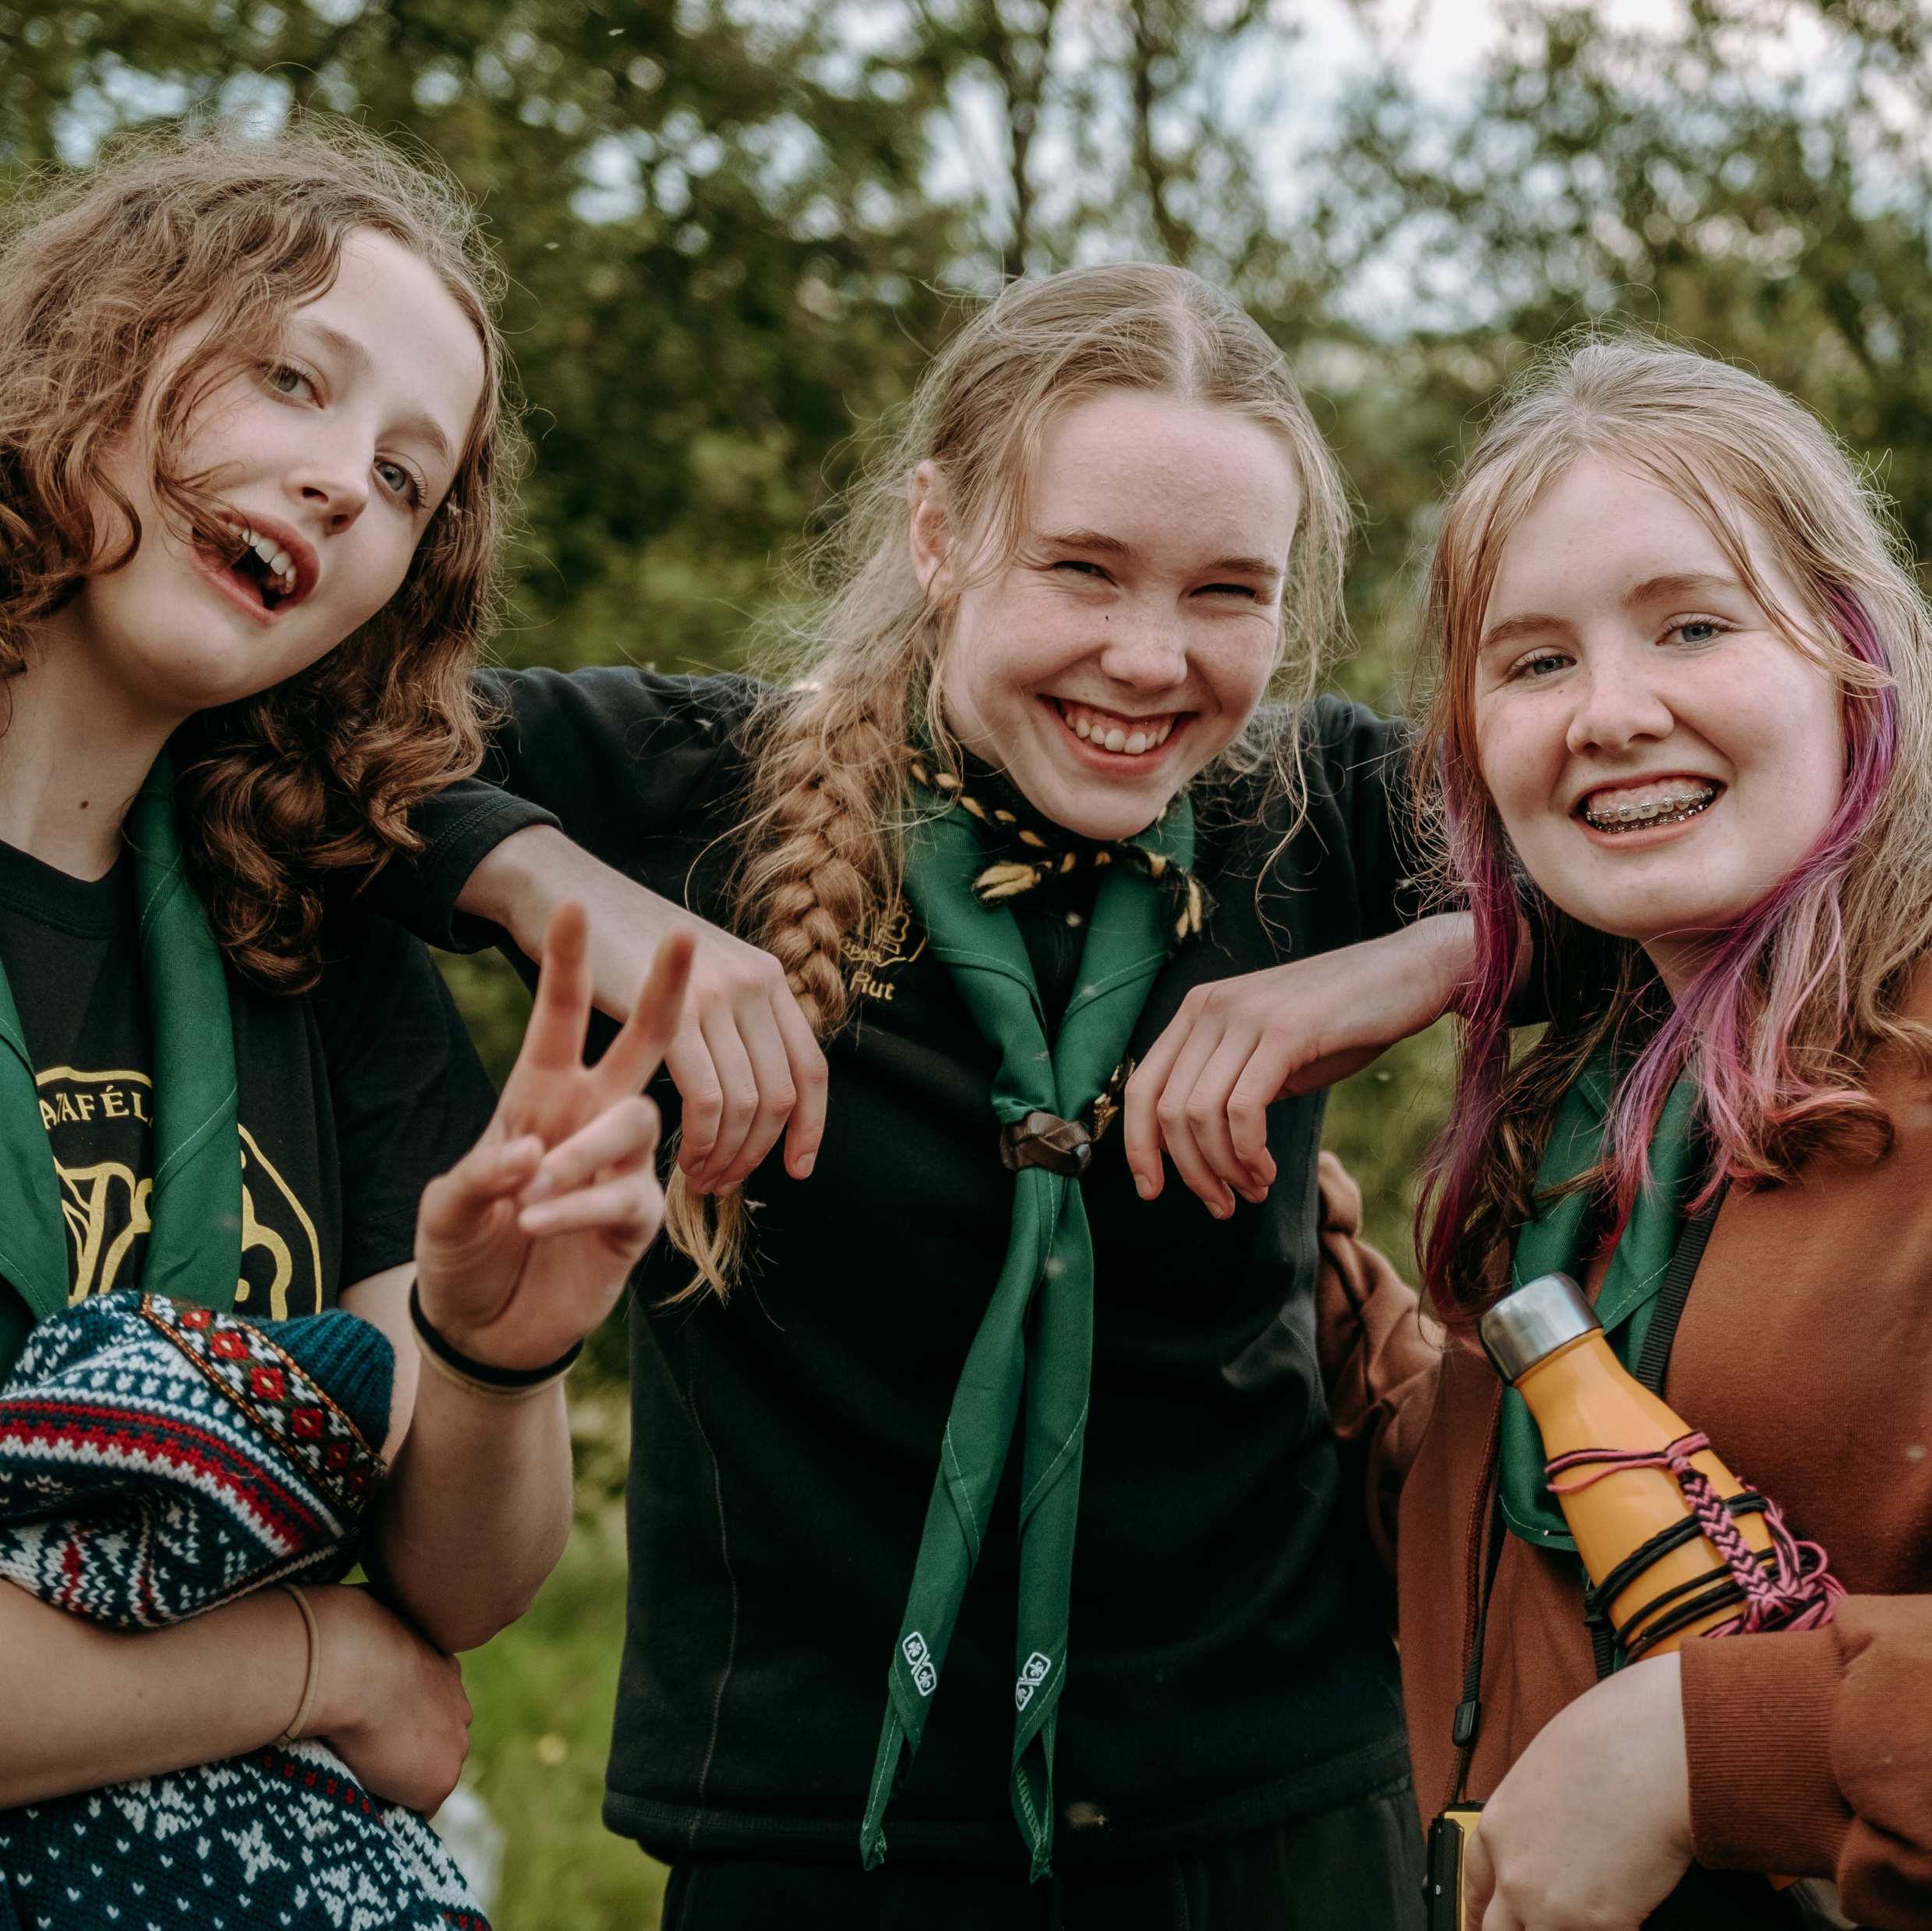
CHALLENGES
Language barrier
Little to no follow-up
Safe from harm
Supporting the whole country
Time consuming
Things are always changing

Slide 38
WHAT CAN WE LEARN?

