Slide 1
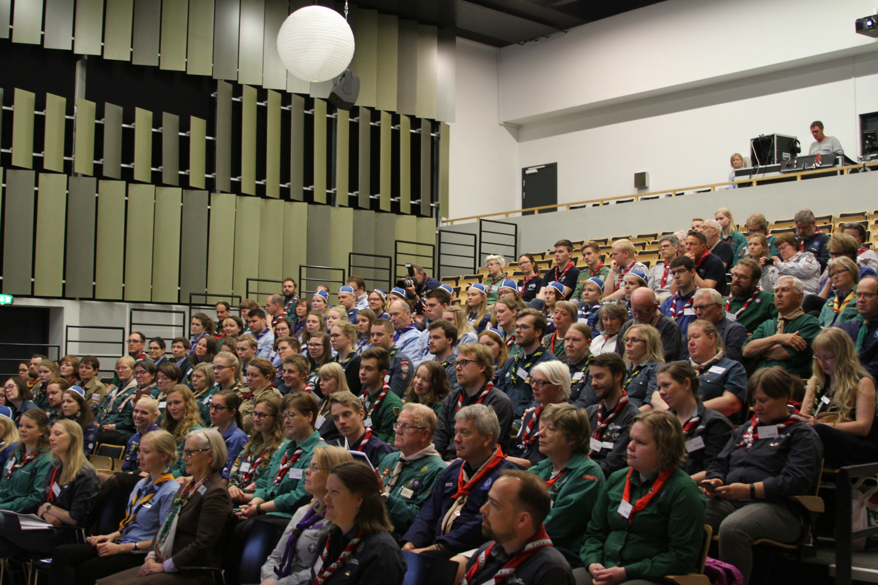
Intro to the NSK
Joel Bergstrand, former IC WOSM, Scouterna
Eirik Ulltang Birkeland, former IC WOSM, Speiderne i Norge

Slide 2
What is the NSK?
“The Nordic Guide and Scout fellowship exists to create opportunities for cooperation, exchanges of experiences and understanding of the Nordic cultures.” (Vision…, section “Mission”)
So what is it?
exchange
likemindedness!
Conference
political cooperation
IC meetings
events
first international arena?
role-based meetings

Slide 3
The bodies of the NSK
The Committee / komiteen: two members from each of the Nordic countries, preferably IC WAGGGS and IC WOSM
The Presidency / formannskapet: one of the Nordic countries, represented by the two committee members from that country
The Secretariat / sekretariatet: members from the presidency country that run the “daily operations” of the Presidency and support the NSK in its activities
The Conference / konferansen: this event, held every three years
The Presidium / presidiemøtet: the governing body of the Conference

Slide 4
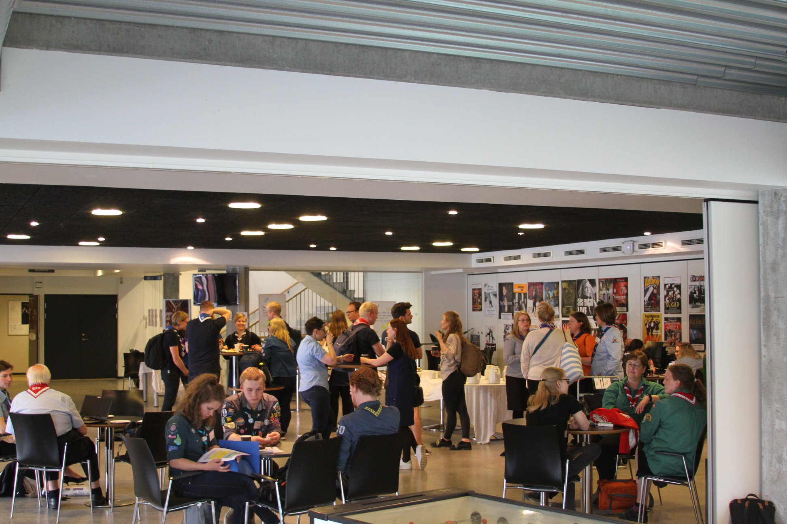
The Nordic Guide and Scout Conference
Held every three years by the presidency that is ending its mandate
Now: Faroe Islands, next time: Sweden
Less formal and “business-driven” than e.g. the European conferences and world conferences
Role-based participation: find your “counterparties” from the other Nordic countries!

Slide 5
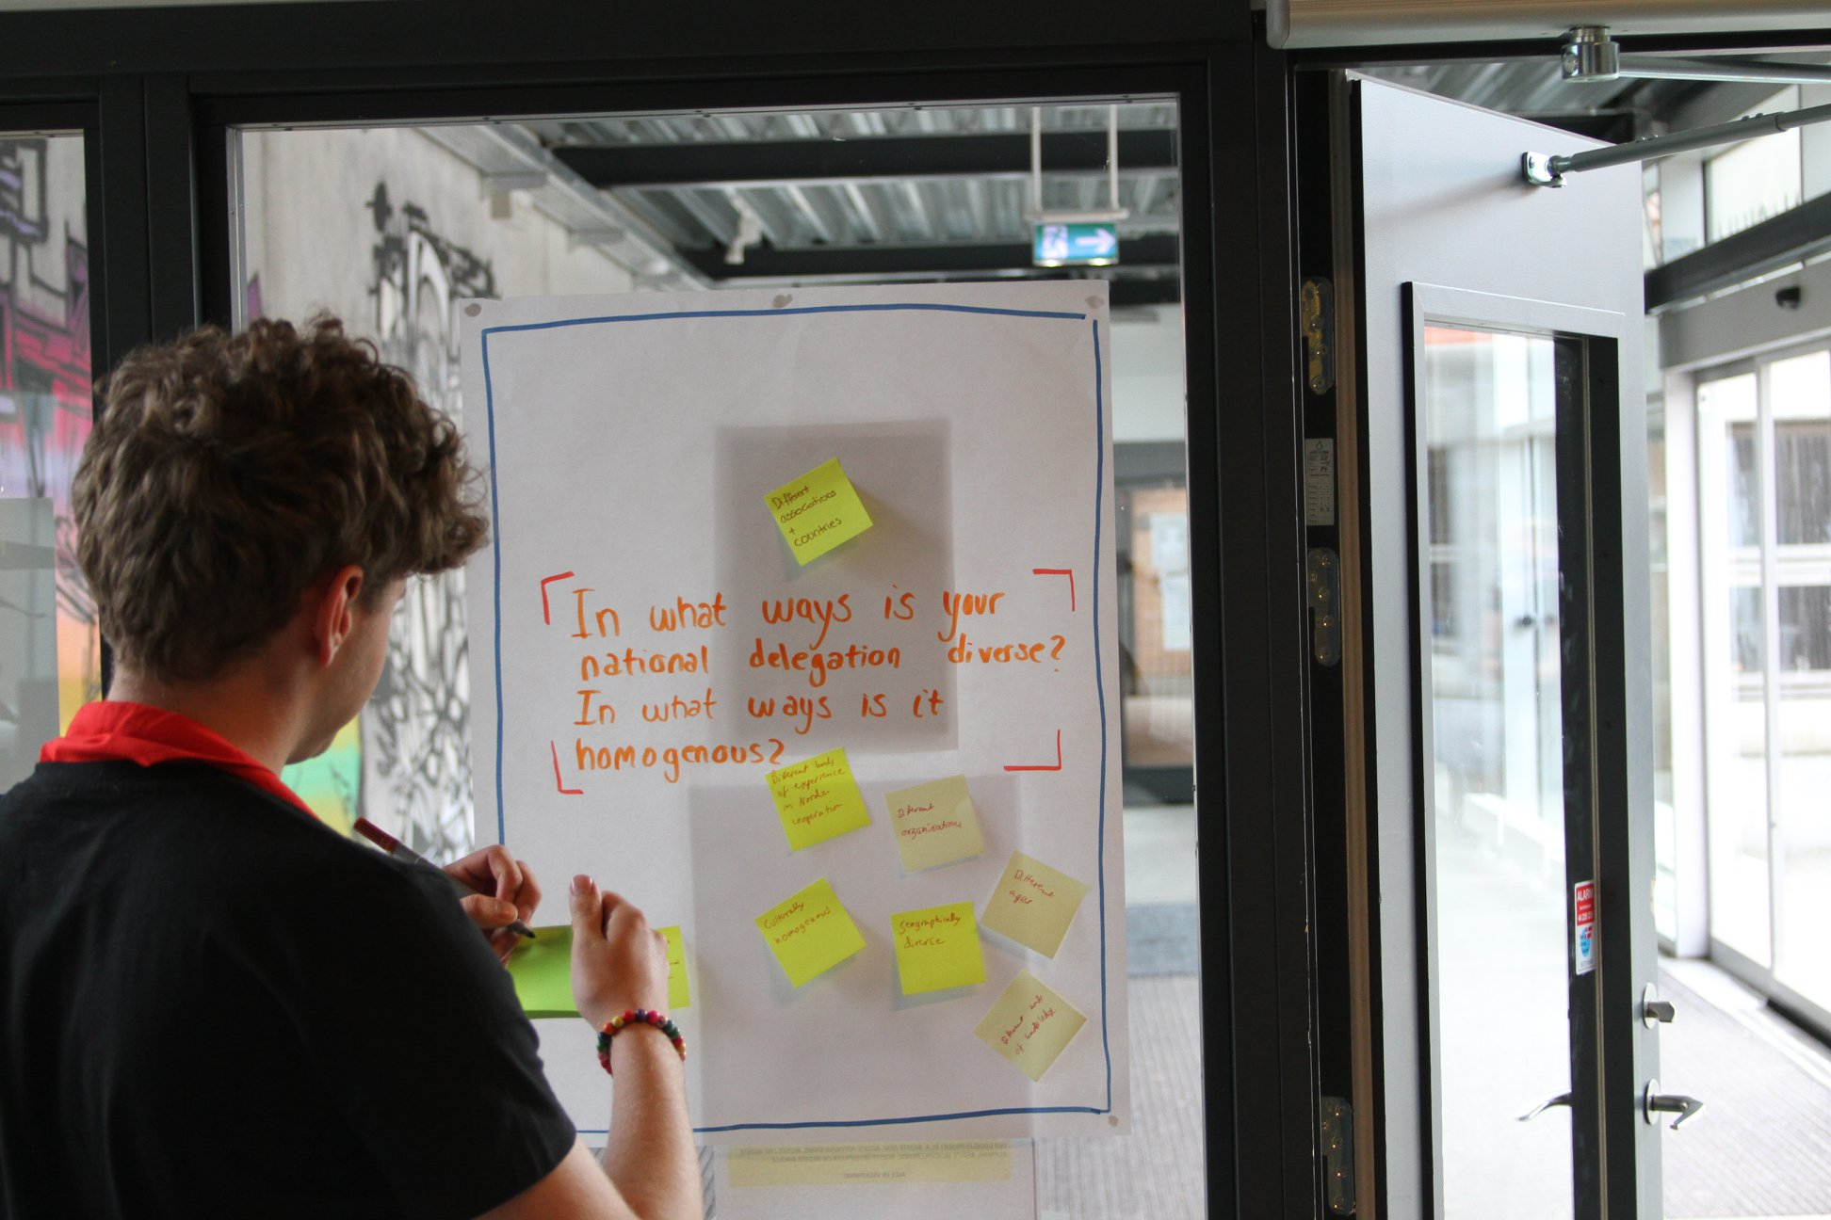
What is the purpose of the Conference?
Exchange of experiences
Sharing of best practices
Updates on “what’s cooking” in each of the countries
Exchange of inspiration
What do we want to share with the other Nordic countries?
What are we proud of?
Networking
Who should I contact in Iceland about leadership training?
Who should I contact in Finland about growth?
Etc., etc.
Tightly bound networks make for even better Guiding and Scouting!

Slide 6
Visjon, misjon og samarbeidsgrunnlag (Vision, Mission and Cooperative Basis)
The document that regulates our cooperation
States the purpose(s) of our cooperation, the aims, the bodies that the cooperation consists of and how it is organised
Revised at each Nordic Conference
Vision: Spejder möter scout, forbund möter korps, skátun möter samfunn

Slide 7
Virksomhetsplan (Activity Plan)
Regulates the activities of the NSK and who will host which event when in a three-year period (between two conferences)
Currently: Ung i Norden, Nordic Adventure Race, Nordic Trefoil-Woodbadge training, function-based meetings, Go Global, NSK Meeting, NSK Conference
Revised at each Nordic Conference

Slide 8
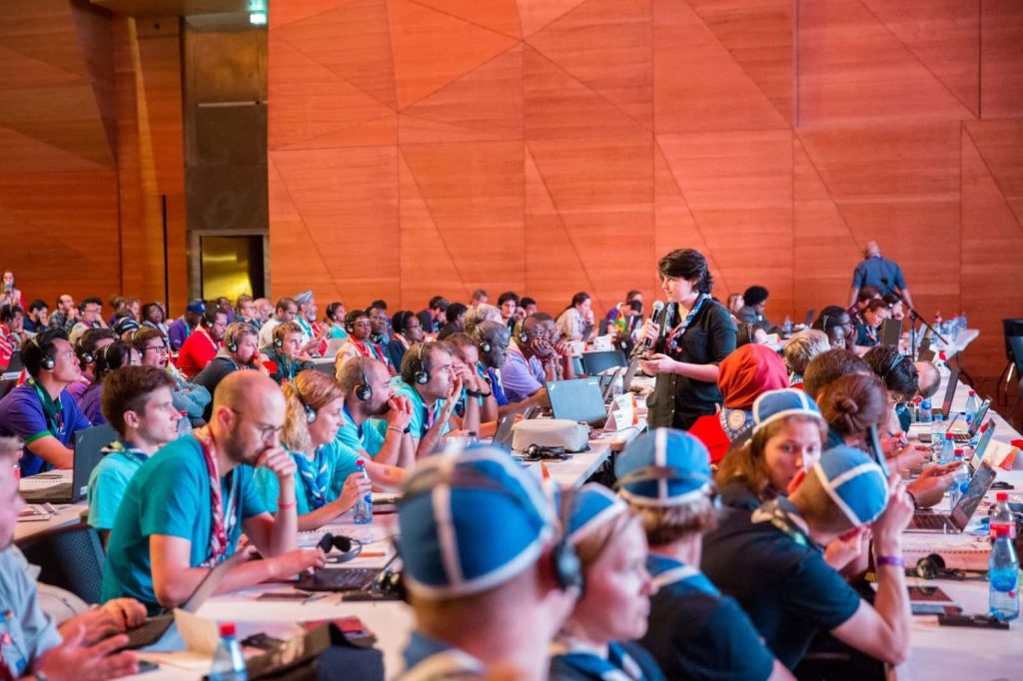
Political cooperation
The Nordic cooperation is an important arena for discussions on topics on European and world level in WAGGGS and WOSM
Here, we…
Prepare for conferences together
Discuss resolutions/motions, strategies, constitutional amendments, etc.
Support each other’s candidacies and bids
…but we vote individually and not as a block
Source: WOSM (scout.org)

Slide 9
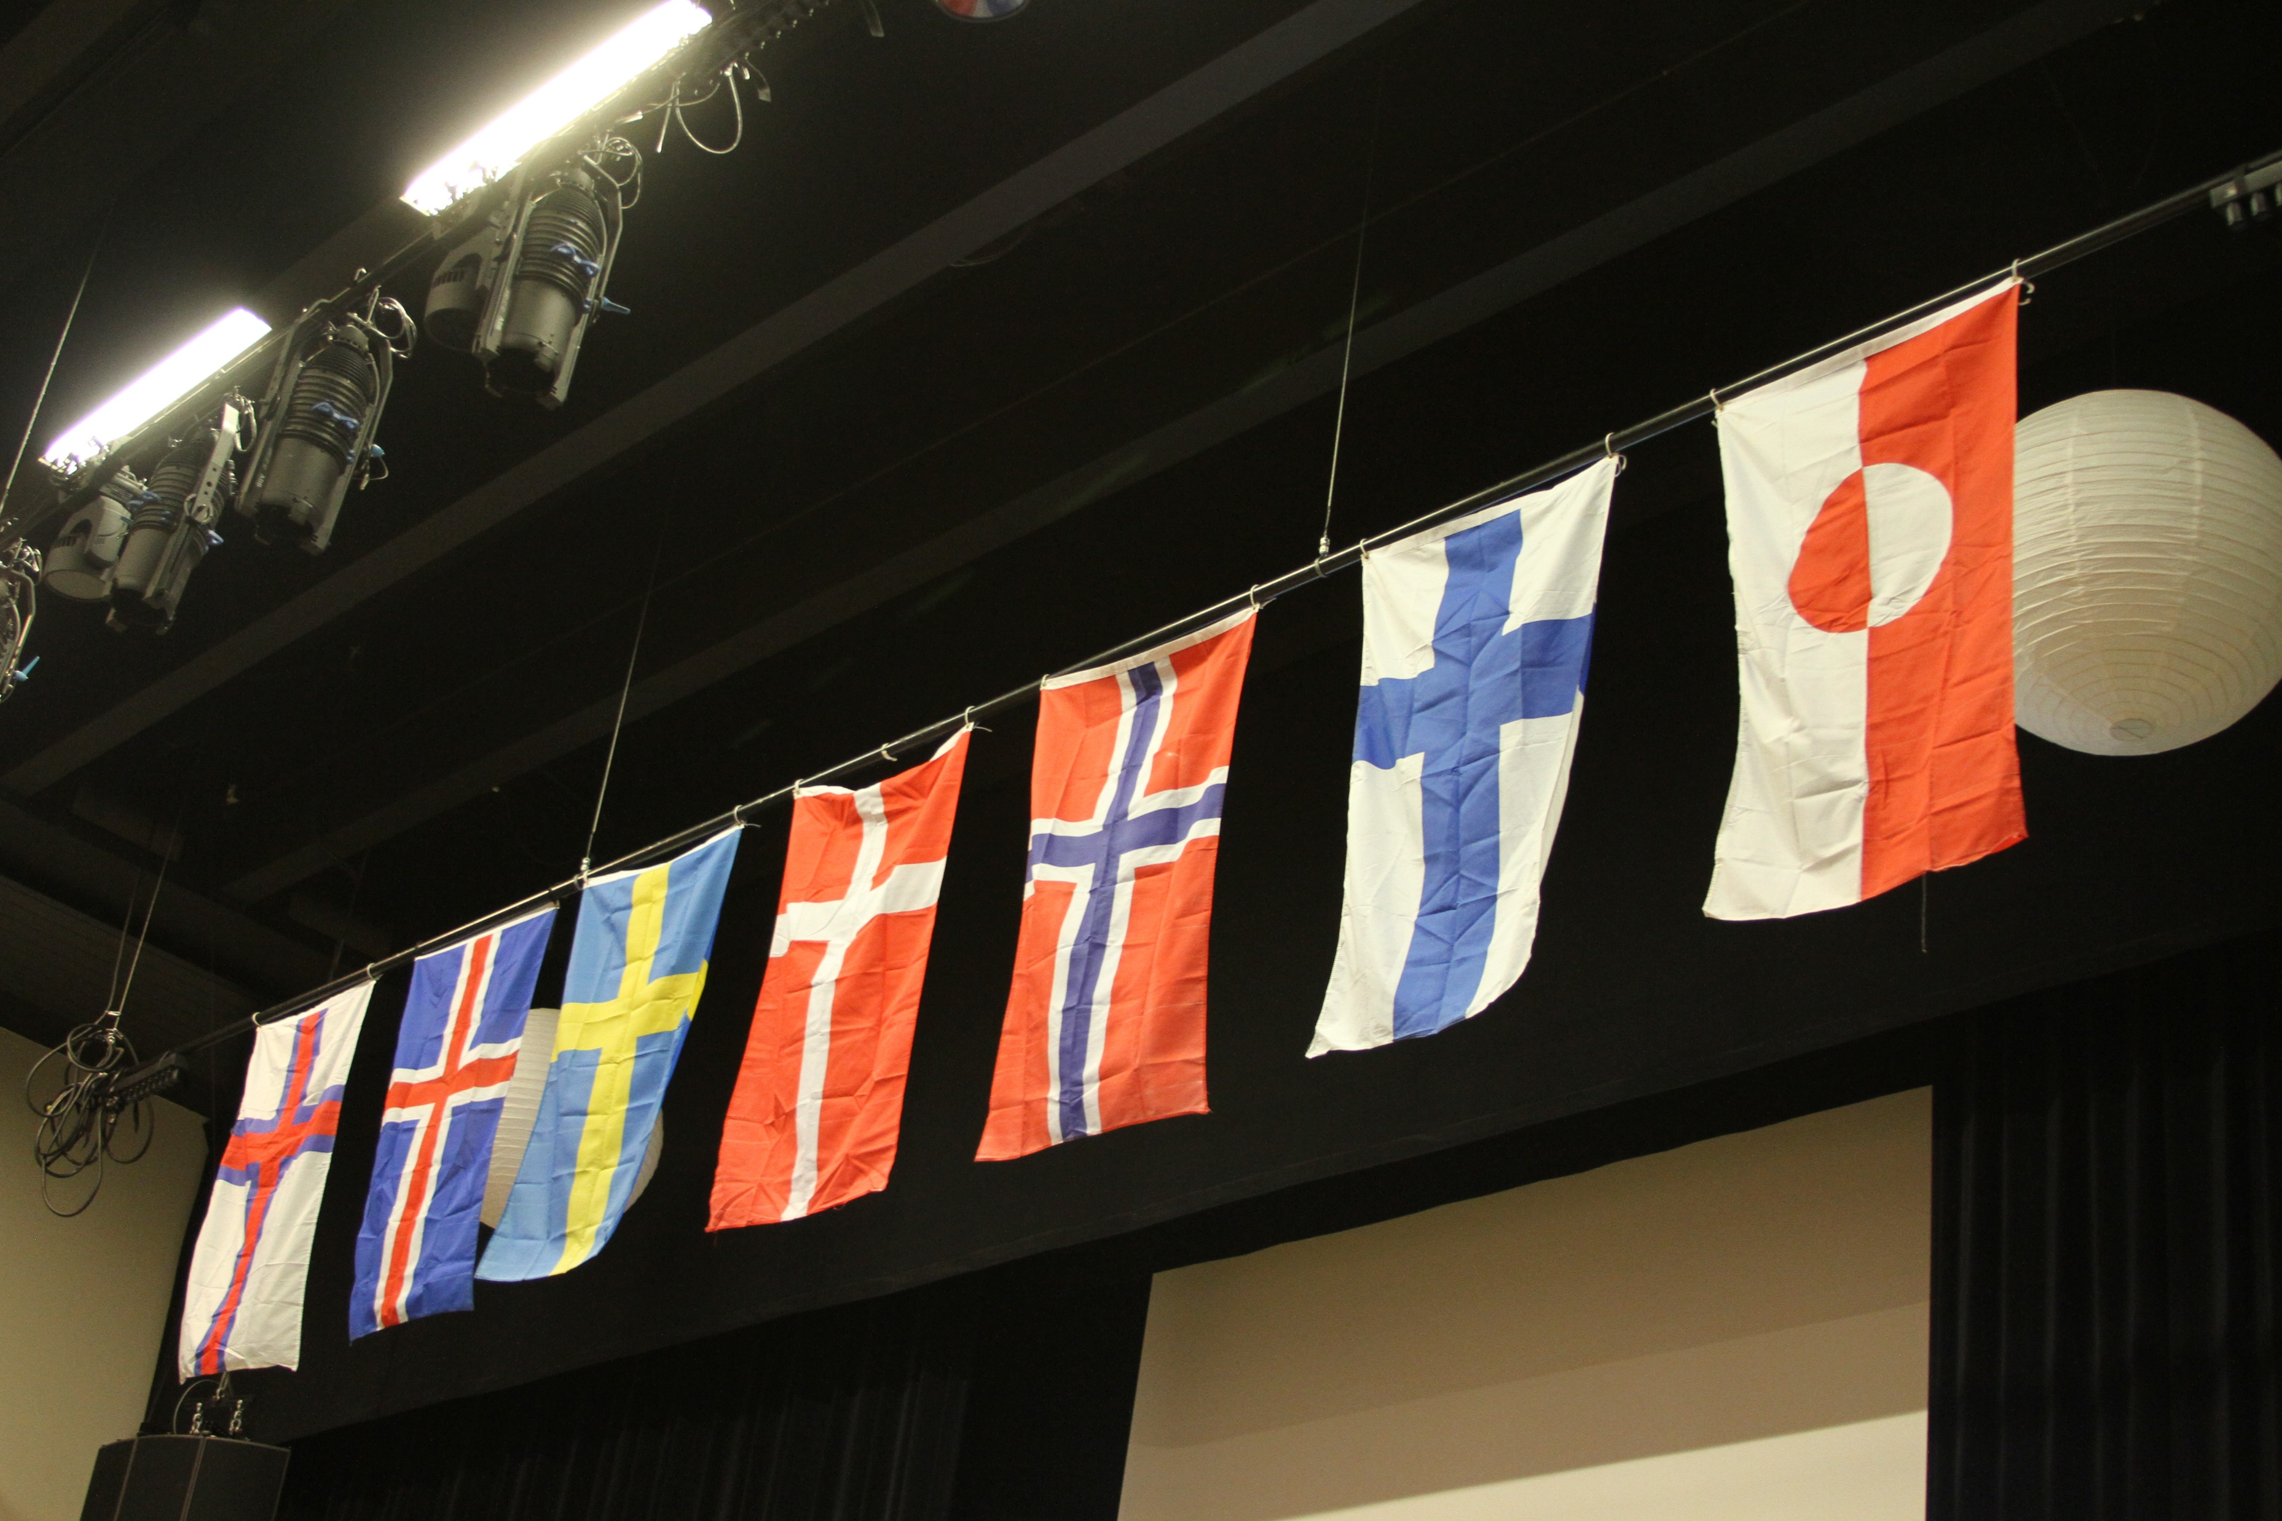
Languages in the Nordic cooperation
“Due to our cultural ancestry Scandinavian is the main language in the Nordic cooperation. Within Nordic Guiding and Scouting it is possible to speak Scandinavian or English in the Nordic context. No participant shall be discriminated against because they speak only one of the languages.” (Vision…, section 3)
Feel free to speak either Scandinavian or English – translations will be provided!
Why not view this as an opportunity to practice your Scandinavian and your understanding of the other languages?
English is always accepted, but please keep in mind that it is the third language of some of the participants, so do not assume that it is the easiest for everyone
In short: be respectful and patient with others!

