Slide 1
The Scout Method Review

Slide 2
What do I plan to say?
The background
Why do a review of the Scout Method?
The Process
What did we do and think along the way?
The Result
What ended up being adopted?

Slide 3
Background

Slide 4
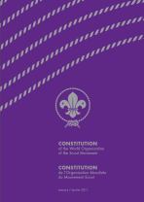
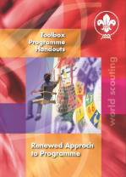
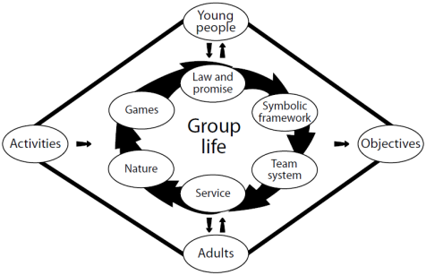
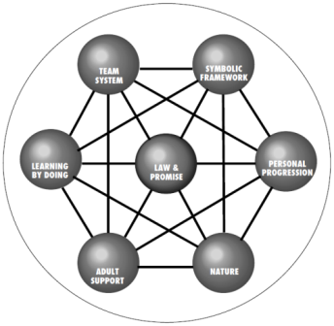
Which Scout Method?
The Scout Method is a system of progressive self-education through:
A promise and law.
Learning by doing.
Membership of small groups (for example the patrol), involving, under adult guidance, progressive discovery and acceptance of responsibility and training towards self-government directed towards the development of character, and the acquisition of competence, self-reliance, dependability and capacities both to cooperate and to lead.
Progressive and stimulating programmes of varied activities based on the interests of the participants, including games, useful skills, and services to the community, taking place largely in an outdoor setting in contact with nature.
Notes:
In 2014 the World Scout Youth Programme Policy review unit had found that it was very confusing with at least three different versions of the Scout Method in institutional documents:
Constitutional text: 1977
The Essential Characteristics of Scouting + Scouting: An Educational System: 1998
RAP: 2005
1st World Scout Education Congress, Hong Kong 2013
- Need to revisit Scout Method
The Scout Method was praised for its effectiveness and participants emphasized the importance of reinforcing its application, but have also recognized the need for revisiting it, in order to ensure our relevance in today’s fast-changing societies. (p. 11)
Scout Method
The Scout Method, even though it has been in use for several decades, is still valid in our times. It is important, therefore, to reinforce it and to make sure tools are created for its correct use, focusing on the fact that it is a unique product that Scouting has to offer. Additionally, we should:
• Re-examine our educational strategies and demonstrate how the Scout Method complements formal education.
• Re-evaluate the realities of each element of the Scout Method to ensure Scouting is deriving and actually increasing the greatest value possible through a relevant curriculum.
• Apply the Scout Method to ensure the goal of youth participation.
(p.37)

Slide 5
Reconsider
Resolution 8/14 (World Scout Youth Programme Policy)
The Conference
…
urges the World Scout Committee to put in place a process, informed by the results of the World Scout Youth Programme Policy review process, to reconsider the way in which the Scout Method related educational matters are expressed, and take all educational and constitutional action needed
…
Notes:
Because of their findings regarding the Scout Method, the World Scout Youth Programme Policy review unit included a passage about the Scout Method in the conference resolution that adopted the World Scout Youth Programme Policy in 2014.

Slide 7
Process

Slide 8
Studying
Discussing
Drafting
Commenting
Reviewing
Drafting
Proposing
Voting
Notes:
We started out by studying …
What had been written previously about the Scout Method.
What had been said at the 1st World Scout Education Congress about the Scout Method.
What WAGGGS says about the Girl Guide and Girl Scout Method (constitution) and the “educational method” presented in e.g. Prepared to Learn – Prepared to Lead and Learning to Thrive.
Educational and learning theory.
Global trends in education.
Then we drafted a first concept paper, which was sent for commenting. We then reviewed the comments, scrapped our original idea (see next slide), and drafted a new paper, which was better received, and therefore formed the basis of the conference proposals by the World Scout Committee, which were voted upon, and adopted, by the Conference.

Slide 9
Always and sometimes
1st meeting idea:
Some elements “always”
Some elements “regularly”
Criticised as too complex
Notes:
At the first meeting, we came up the with the idea that while the traditional (1998 – 7-elements) Scout Method in principle describes what should always be present in Scouting, there were some further elements that are essential for Scouting to be Scouting, but which are not present always, but which need to be present regularly.
This formed the basis for the first concept paper, which presented a Scout Method consisting of the seven “core elements” from the 1998 work, and three additional elements, which were to be present “regularly” in the Youth Programme, but not at all times.
This concept was, however, criticised as being too complex, and it was therefore dropped.

Slide 10
Result

Slide 11
The Scout Method
The Constitutional Text
The Simple Text
The Full Text

Slide 12
The Scout Method

Slide 13
The Scout Method

Slide 14
Group Discussions
Go with your curiosity / interest!
Example questions
Is there a special Nordic aspect / perspective to an element?
Does something particularly interesting happen in the interaction of two or more elements
Is any element or interaction particularly challenging in today’s Nordic societies?
Or any other question catching your interest.

Slide 15
?

Slide 16
THANK YOU!

