Slide 1
MAKING HEROES OUT OF TRAINERS Questions? Send an e-mail to erika.gilbertsson@scouterna.se

Slide 2
Scouterna
Redo för livet

Slide 3
The bridge
Safe from harm
Leda scouting
Notes:
Ledarskapsön (the leadership island) is the training system for the Scouts and Guides in Sweden. On the island people with different background, skills and experience meet. All who contribute to an organisation with the best leaders.
On the island you create your own path after the interests and need you have.
3

Slide 4
The lake of reflection
Value based leadership
Wood badge
Ditt personliga ledarskap

Slide 5
The organisation height
Leda avdelning
Leda kår
Normkritiskt ledarskap

Slide 6
The outdoor clearing
Redo för naturen
Friluftsledarkurserna

Slide 7
The adventure cove
Leda patrull

Slide 8
The trainers cape
Train the trainer
Handledarutbildningen
Kursansvarigutbildningen

Slide 9
The Islet of interest
Lokala intressekurser

Slide 10
SUCCESS FACTORS

Slide 11
Demand analysis
Survey
Spread the survey
Information region, age, last training, leader experience
Wide questions
Personas
Development of courses

Slide 12
The Ledarship island - as a symbolic framework
Easy to understand
Easy to sell
Easy to communicate
Notes:
All new leaders start their journey on the island by disembarkation on the bridge. Here you’ll find the basic leadership training Leda Scouting and the mandatory training Trygga Möten (Safe from harm)
12

Slide 13
The Scouts Leadership College
Training renewal commmittee
National training group
Regional training group
Regional training group
Regional training group
Regional training group
Regional training group
Notes:
Here you will find our trainings on leadership and personal development.
13

Slide 14
The Scouts Leadership College
Economical conditions
Employed personal
Support
Separate organisations
Agefocus
Notes:
On the organisation height is the trainings that will give us both height and overview of the troop and the group work.
14

Slide 15
Training renewal committee
The group which made The Leadership island come true
Shared ledarship
Control documents
Working with individuals strengths
Notes:
The outdoors is in many ways an important part of our organisation. We offer trainings in outdoor life for leaders, scouts and the public.
15

Slide 16
National training group
Responsible for administrating the courses
Initiators for Regional training groups
Quality assurance
Notes:
Here adventure scouts come to develop as leaders. 12-14 year´s of age
16

Slide 17
Regional training groups
Mission to implement training/courses
Collaborate with the national training team and the units/scout leaders
Trainer meeting
Network meeting
Relationships
Notes:
To offer all the possibilities on the island we also need many dedicated trainers. There are courses for trainers and mentors.
17

Slide 18
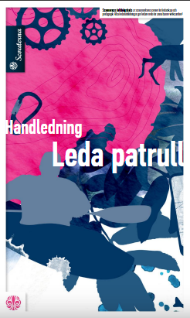
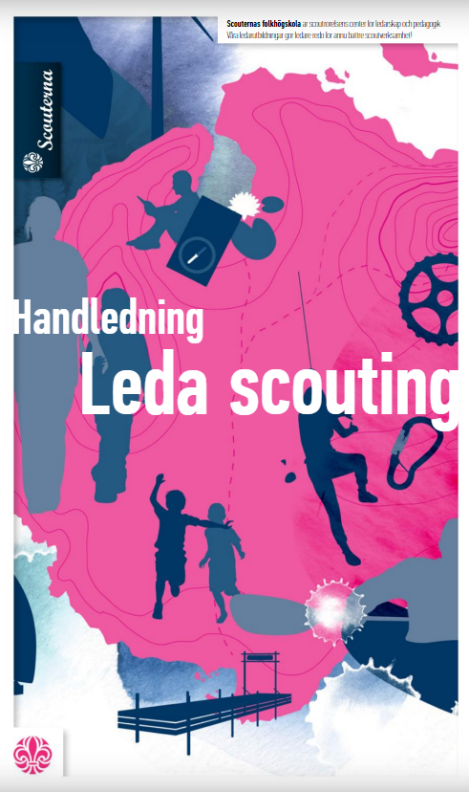
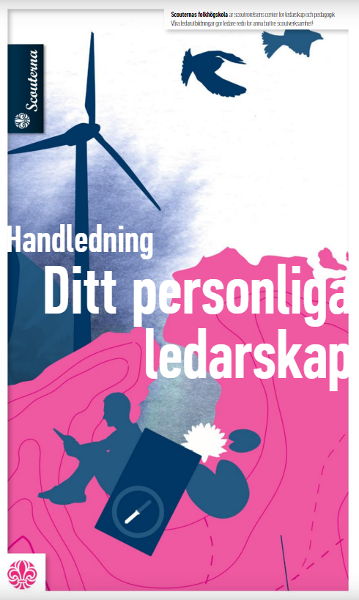
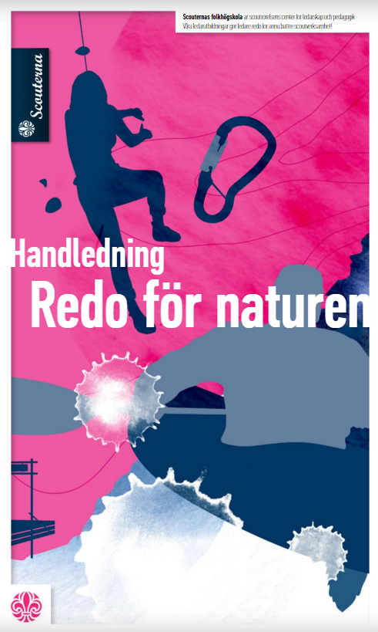
Tutorials
Graphically inspiring
Printed
Available in pdf online
Status for trainers and courses
Notes:
This is a place for great knowledge from all of the various local courses.
18

Slide 19
Chapter for trainers in the tutorials
It's about attitude
How to act, behave and think within the course, as a trainer
Sets the limits for what this course is

Slide 20
Trainers training and meetings
One full weekend with inspiration, workshops etc.
“Training for trainers”
Workshops within the trainers interest
Pick and choose
Number of trainers:
2016: 100 2017: 80
nationell jamboree 2018: 150 2019: 200?
Notes:
Here adventure scouts come to develop as leaders. 12-14 year´s of age
20

Slide 21
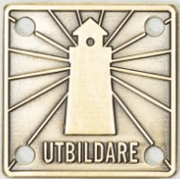
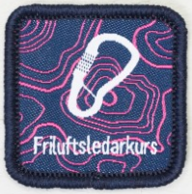
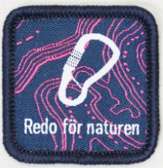
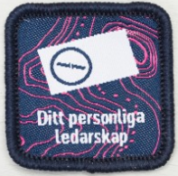
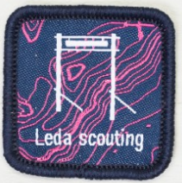
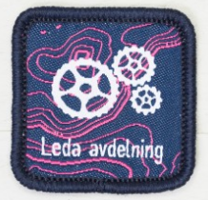
Badges
Notes:
Here adventure scouts come to develop as leaders. 12-14 year´s of age
21

